Slide 1
Carnivorous Plants
Notes:
This PPT includes a variety of slides that connect to different pieces of curriculum in my 8th grade Science class. The slides would not be taught together, but instead would be embedded in lessons that I already teach about these topics. The carnivorous plant portion would be added to connect the content to our classroom plants!

Slide 2
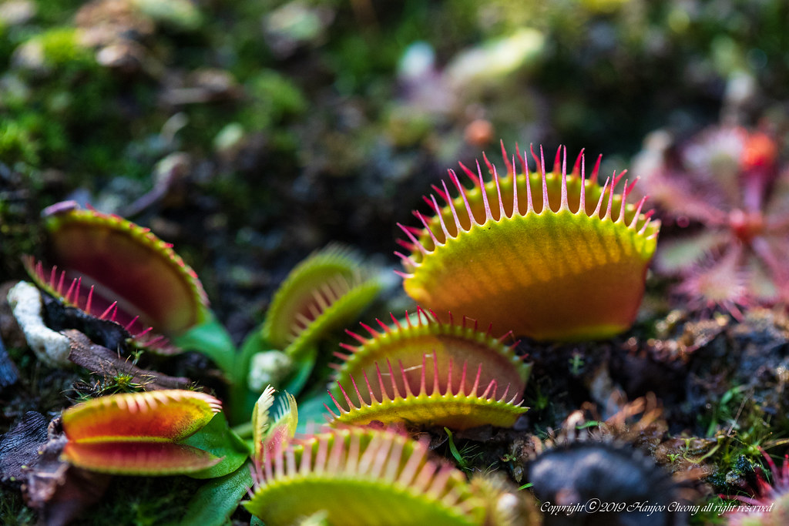
What are Carnivorous Plants?
Watch this video called “What are Carnivorous Plants?”
When you have finished watching, in your notebook, write SIX words to summarize the main ideas from the video.
This Photo by Unknown Author is licensed under CC BY-SA-NC
Notes:
This intro activity includes students watching a video and writing a quick summary of words. The word activity is a means to identify vocabulary and big ideas without explicitly telling students to do so. In groups, students would share their six words. Then on chart paper, they would make a list of their words. Lastly, each table group moves to a new table but leaves their list of words at their original seat. At the new table, the students draw the words that another group wrote down. This activity is both tactile and visual, meeting the learning styles of most students. I have had great success with these types of charting/writing/drawing lessons!

Slide 3
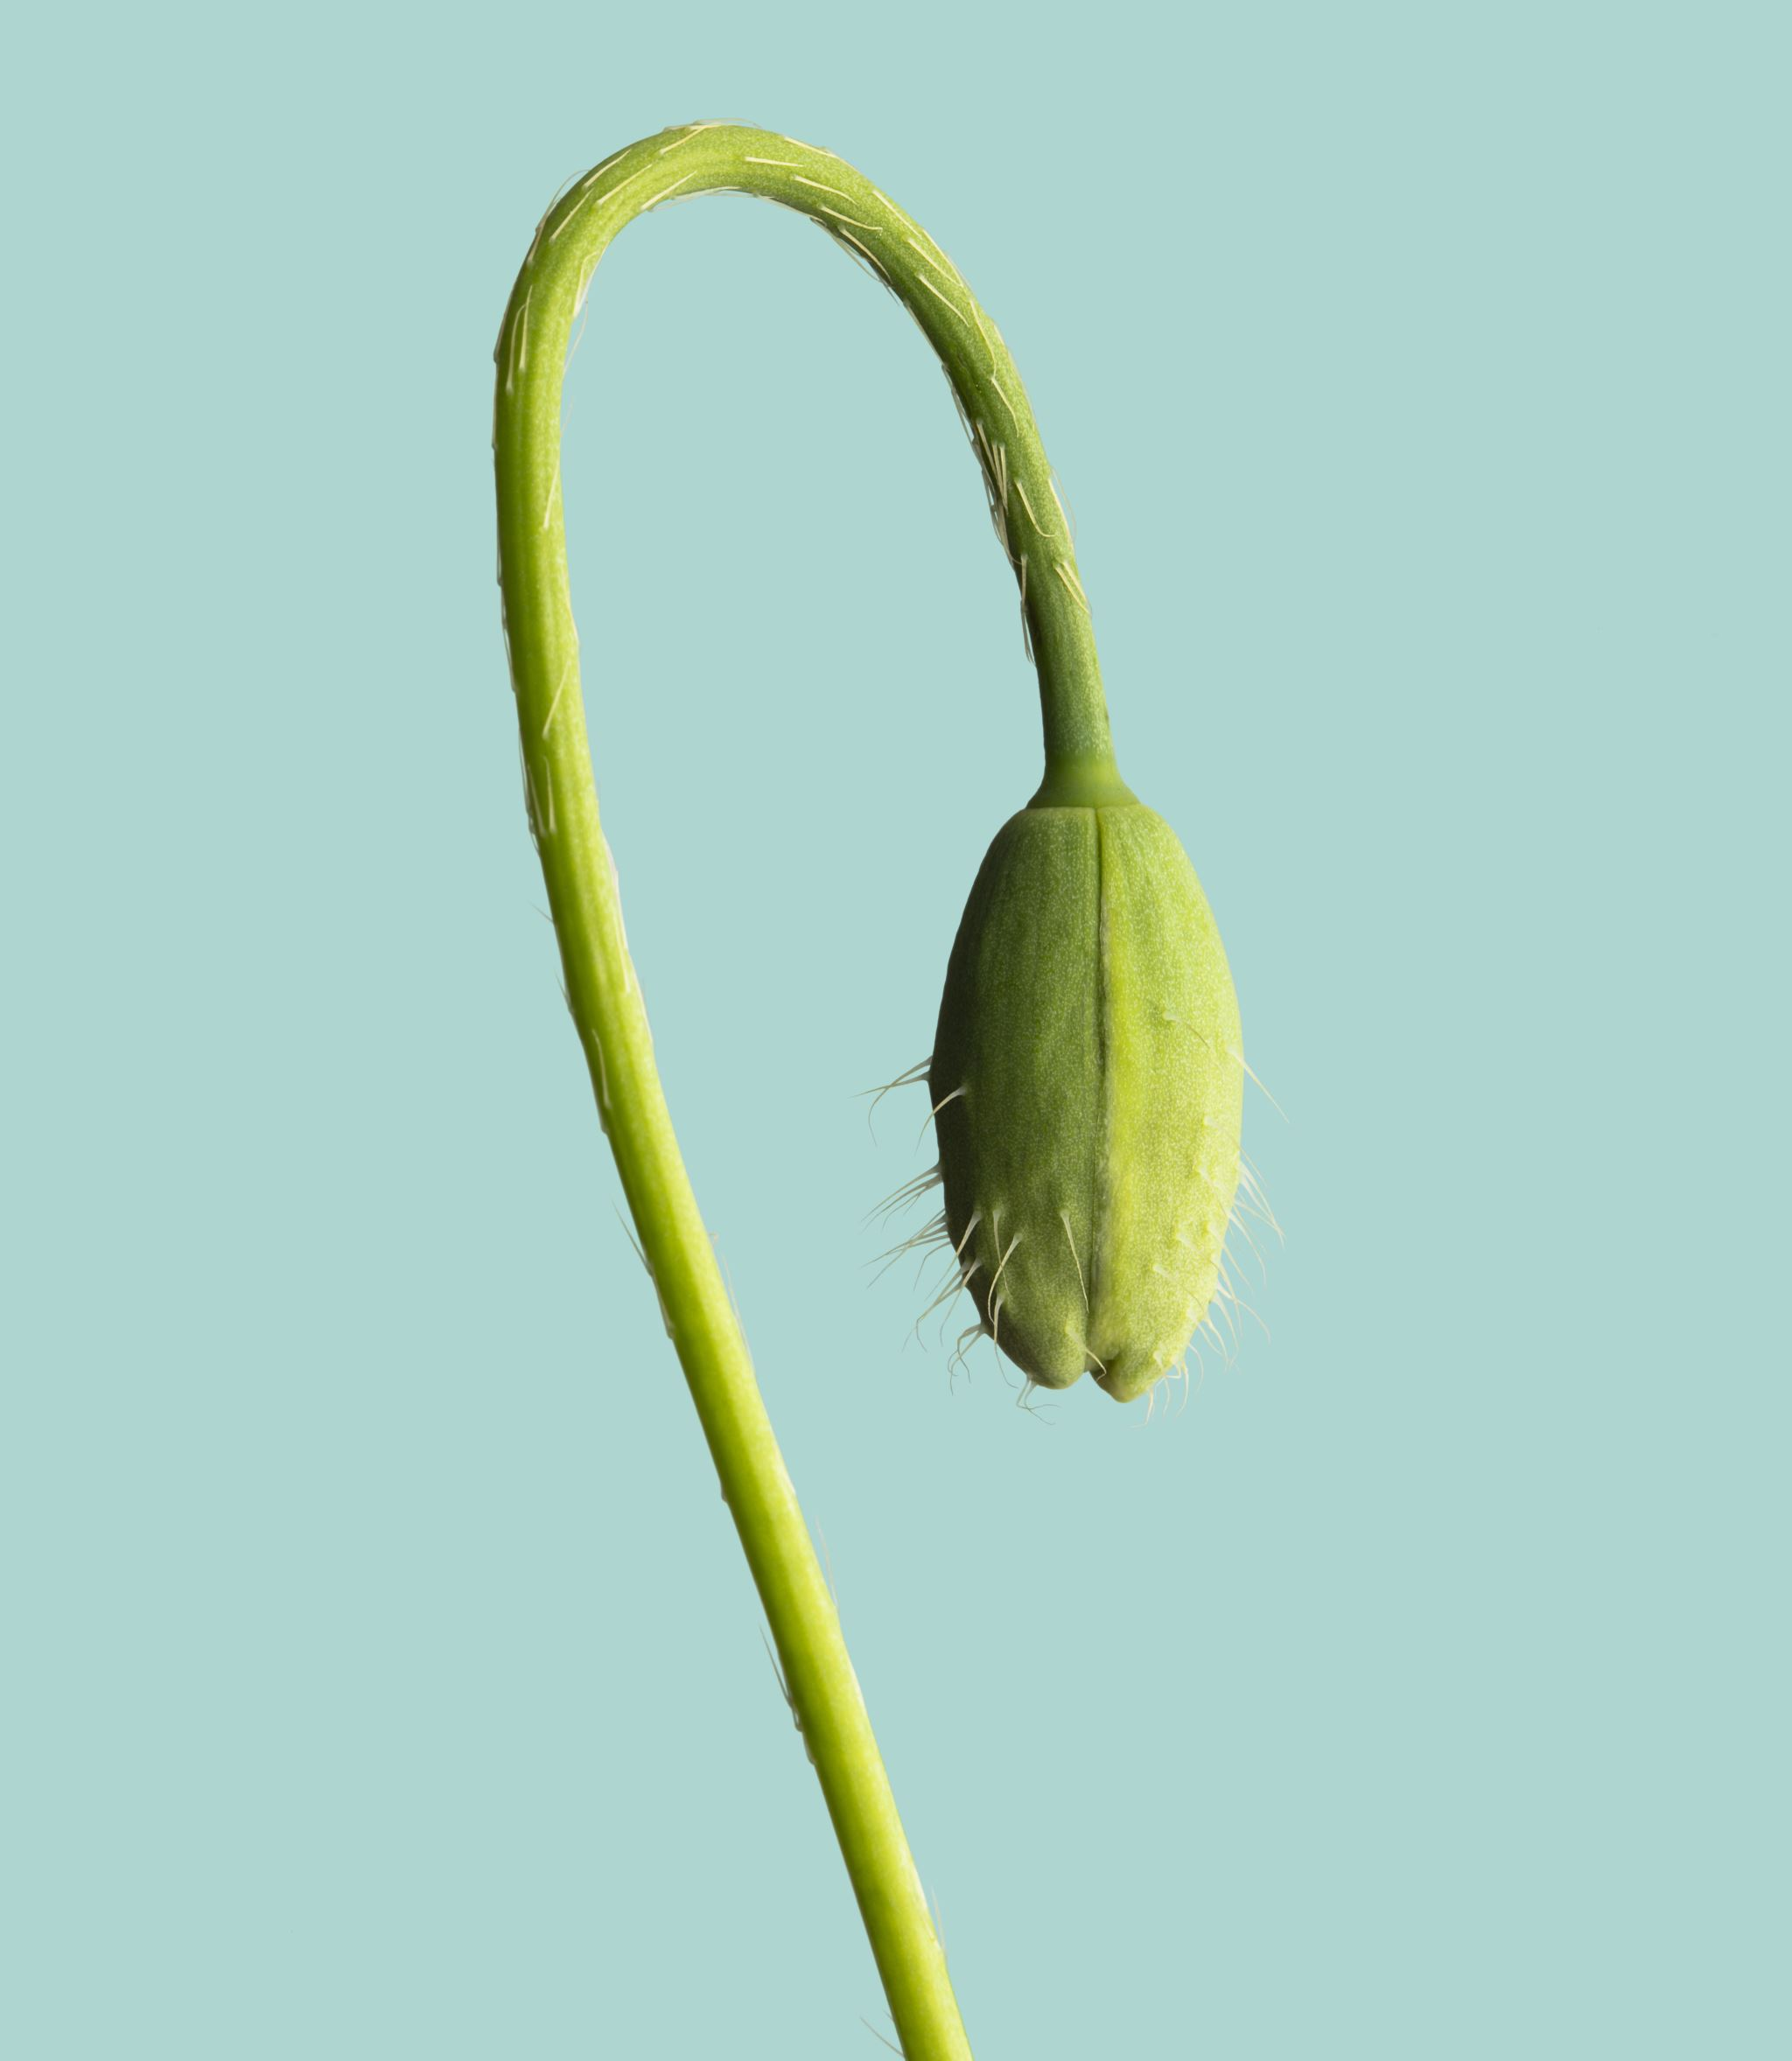
Adaptations Webquest
Choose one of the carnivorous plants below.
Sundew
Cobra Lily
Venus Flytrap
Pitcher Plant
Butterwort
On the next slide, you’ll see several websites. Use one or more websites to research adaptations that the plant uses to survive in its environment. Document and illustrate three (3) adaptations in your notebook.
Notes:
This adaptations activity involves a mini-webquest. Students are asked to choose one type of carnivorous plant. I provide them with several websites, all of which discuss adaptations of carnivorous plants. Not all websites have information about all plants on the list, so students may change their mind about their selected plant, or they may have to look through more than one website to find the required information.
Once students find their information, they need to describe in writing and illustrate three difference adaptations the plant uses to survive.

Slide 4
Websites for Adaptations Webquest
https://shadowhabitat.org/the-amazing-adaptations-of-carnivorous-plants/
https://www.nhm.ac.uk/discover/carnivorous-plants-meat-eaters-of-the-plant-world.html
https://www.ourbreathingplanet.com/6-magnificent-carnivorous-plants/?gclid=Cj0KCQjw6KunBhDxARIsAKFUGs9ME0dpsz4RtPe9yJryhUf_8fqiklWfzsvNRqxxSnxPchf2WieO0xQaAlUOEALw_wcB

Slide 5
Biomes
Using the websites on the previous slide, describe the biome or ecosystem in which you would naturally find your chosen carnivorous plant.
General location on Earth
Type of biome
One specific location (city, park, landmark, etc.)
Climate of biome
Animals that inhabit the biome
Notes:
This activity focuses on the biomes of carnivorous plants. The goal of the activity is to help students understand that carnivorous plants are found in the same biomes with which they are familiar, often surrounded by animals that students already recognize. After students complete their research, they share out the information in groups. They find that many of the plants live in similar habitats, which leads to a discussion and following activity related to how to care for a carnivorous plant indoors.

Slide 6
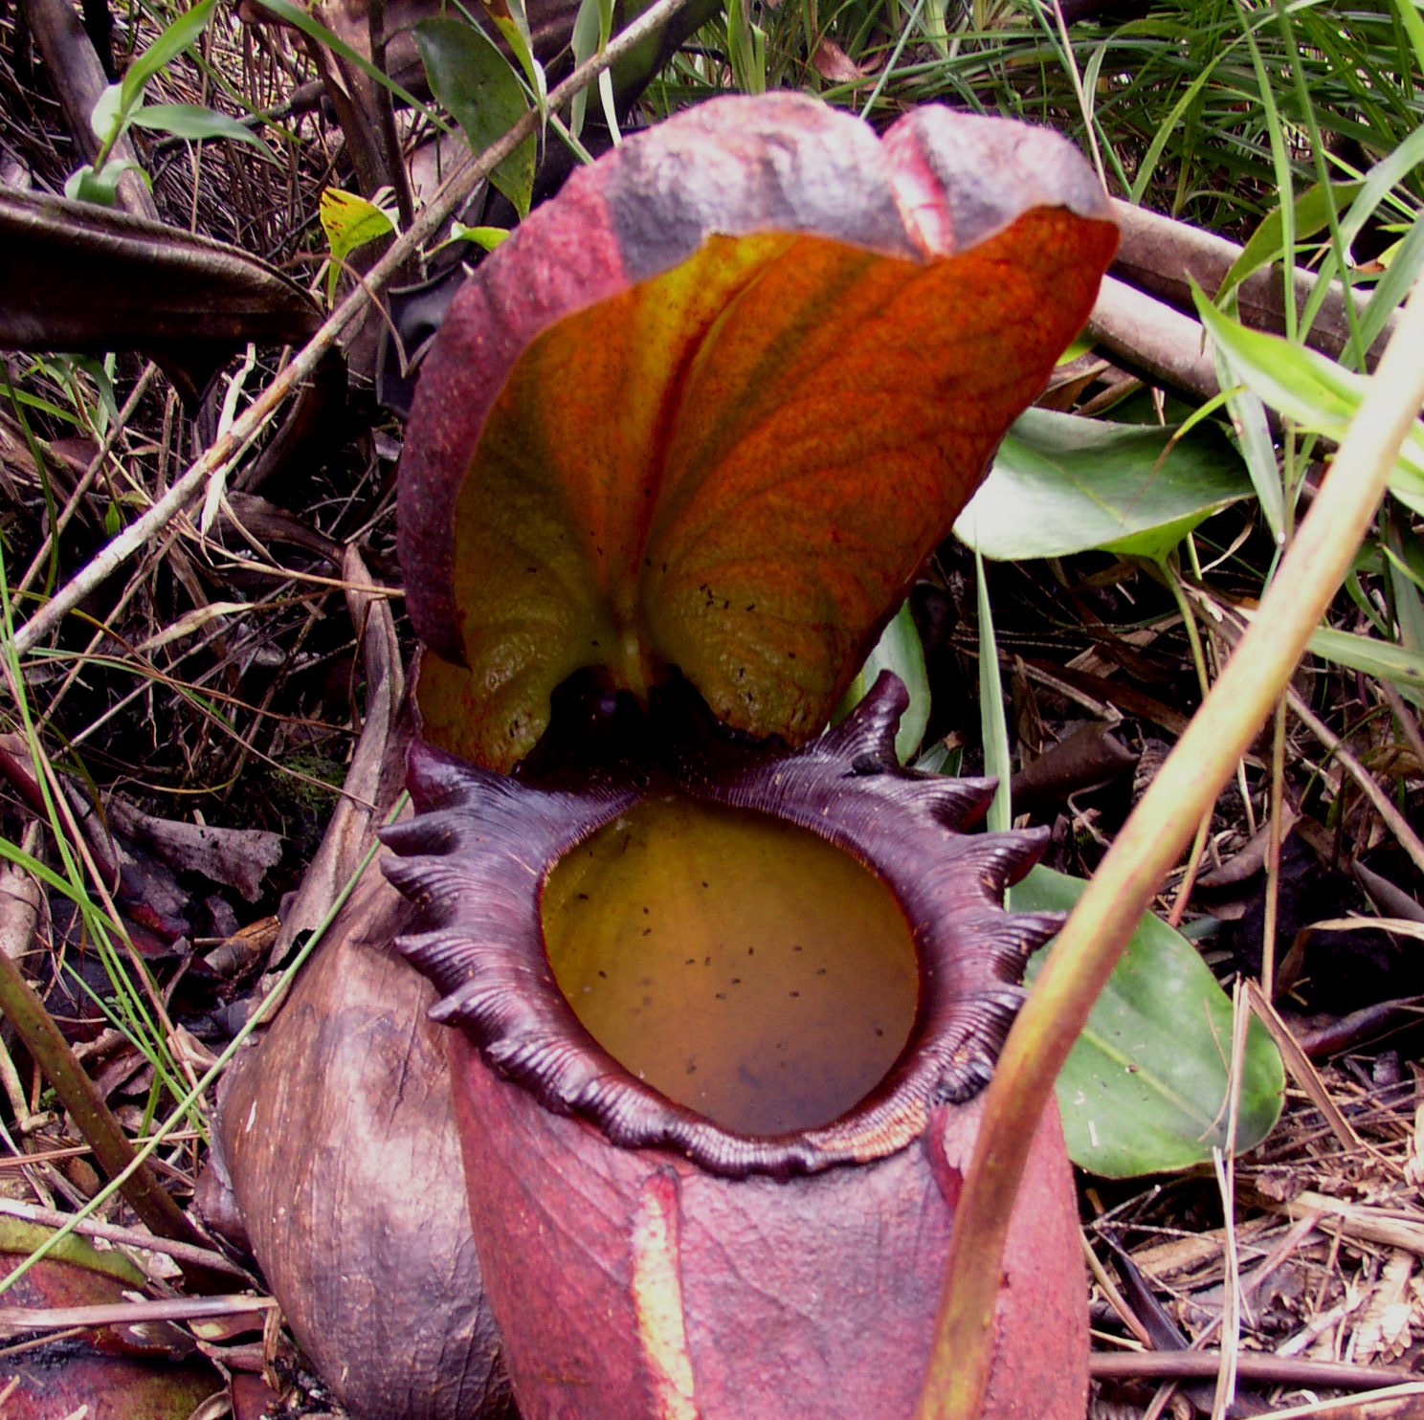
Carnivorus Plant Care
Imagine you were given a carnivorous plant to care for indoors.
Using the Carnivorous Plant Nursery website, describe how you would care for a carnivorous plant. Be specific! Consider location of the plant, food, sunlight, water, air temperature, humidity, etc.
This Photo by Unknown Author is licensed under CC BY-SA
Notes:
Students use the included website to research how to care for a carnivorous plant indoors. This provides them with the understanding of how carnivorous plants are similar and different from houseplants they may have at home or may have seen in a classroom, doctor’s office, etc. This research also allows students to assist with the care of the plants in our classroom that are part of the grant, which gives them life experience caring for a living plant rather than just reading about the plants or watching them sit in our classroom.

Slide 7
How does the Pitcher Plant get its food?
1. Use the code to access the Nearpod lesson on the Pitcher Plant.
Notes:
This part of the lesson includes a Nearpod lesson that would be teacher-guided. Students use a code to access the content, but the teacher “pushes” them through the activities, which include videos, quick checks, open-ended questions, and collaborative boards that allow students to voice opinions on a digital sticky note visible to the class.
This slide would pair with the next slide to help students understand how carnivorous plants eat and how they process cellular energy.

Slide 8
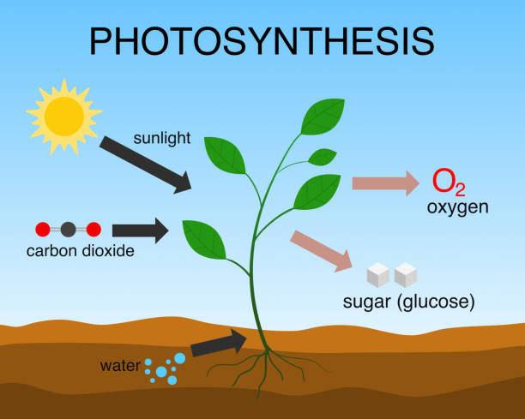
Cellular Energy
Watch this video on carnivorous plants to learn how their digestion works.
Based on what we’ve learned about photosynthesis and referencing the image →, write 4 sentences that explain how a carnivorous plant, despite being carnivorous, still uses solar energy to produce glucose.
Notes:
This slide is a continuation of the previous slide on how carnivorous plants get food. Students should be able to explain in complete sentences how photosynthesis, which they would have already learned about, still is the primary means for a carnivorous plant to generate glucose to then generate energy as ATP for cellular processes, like taking in nutrients and getting rid of waste.

