Slide 1
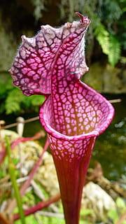
That Plant Does What??
High School Biology

Slide 2
LESSON INFORMATION
Duration: 2-3 class periods (approximately 60-90 minutes)
Learning Objectives:
Understand the unique adaptations and mechanisms that carnivorous plants have developed to obtain nutrients.
Identify and describe different types of carnivorous plants and their habitats.
Analyze the ecological significance of carnivorous plants in their ecosystems.

Slide 3
LESSON INFORMATION
Duration: 2-3 class periods (approximately 60-90 minutes)
Learning Objectives:
Identify the threats and challenges to carnivorous plant populations.
Explore the importance of conserving carnivorous plants in ecosystems.
Discuss conservation strategies and efforts to protect carnivorous plants.

Slide 4
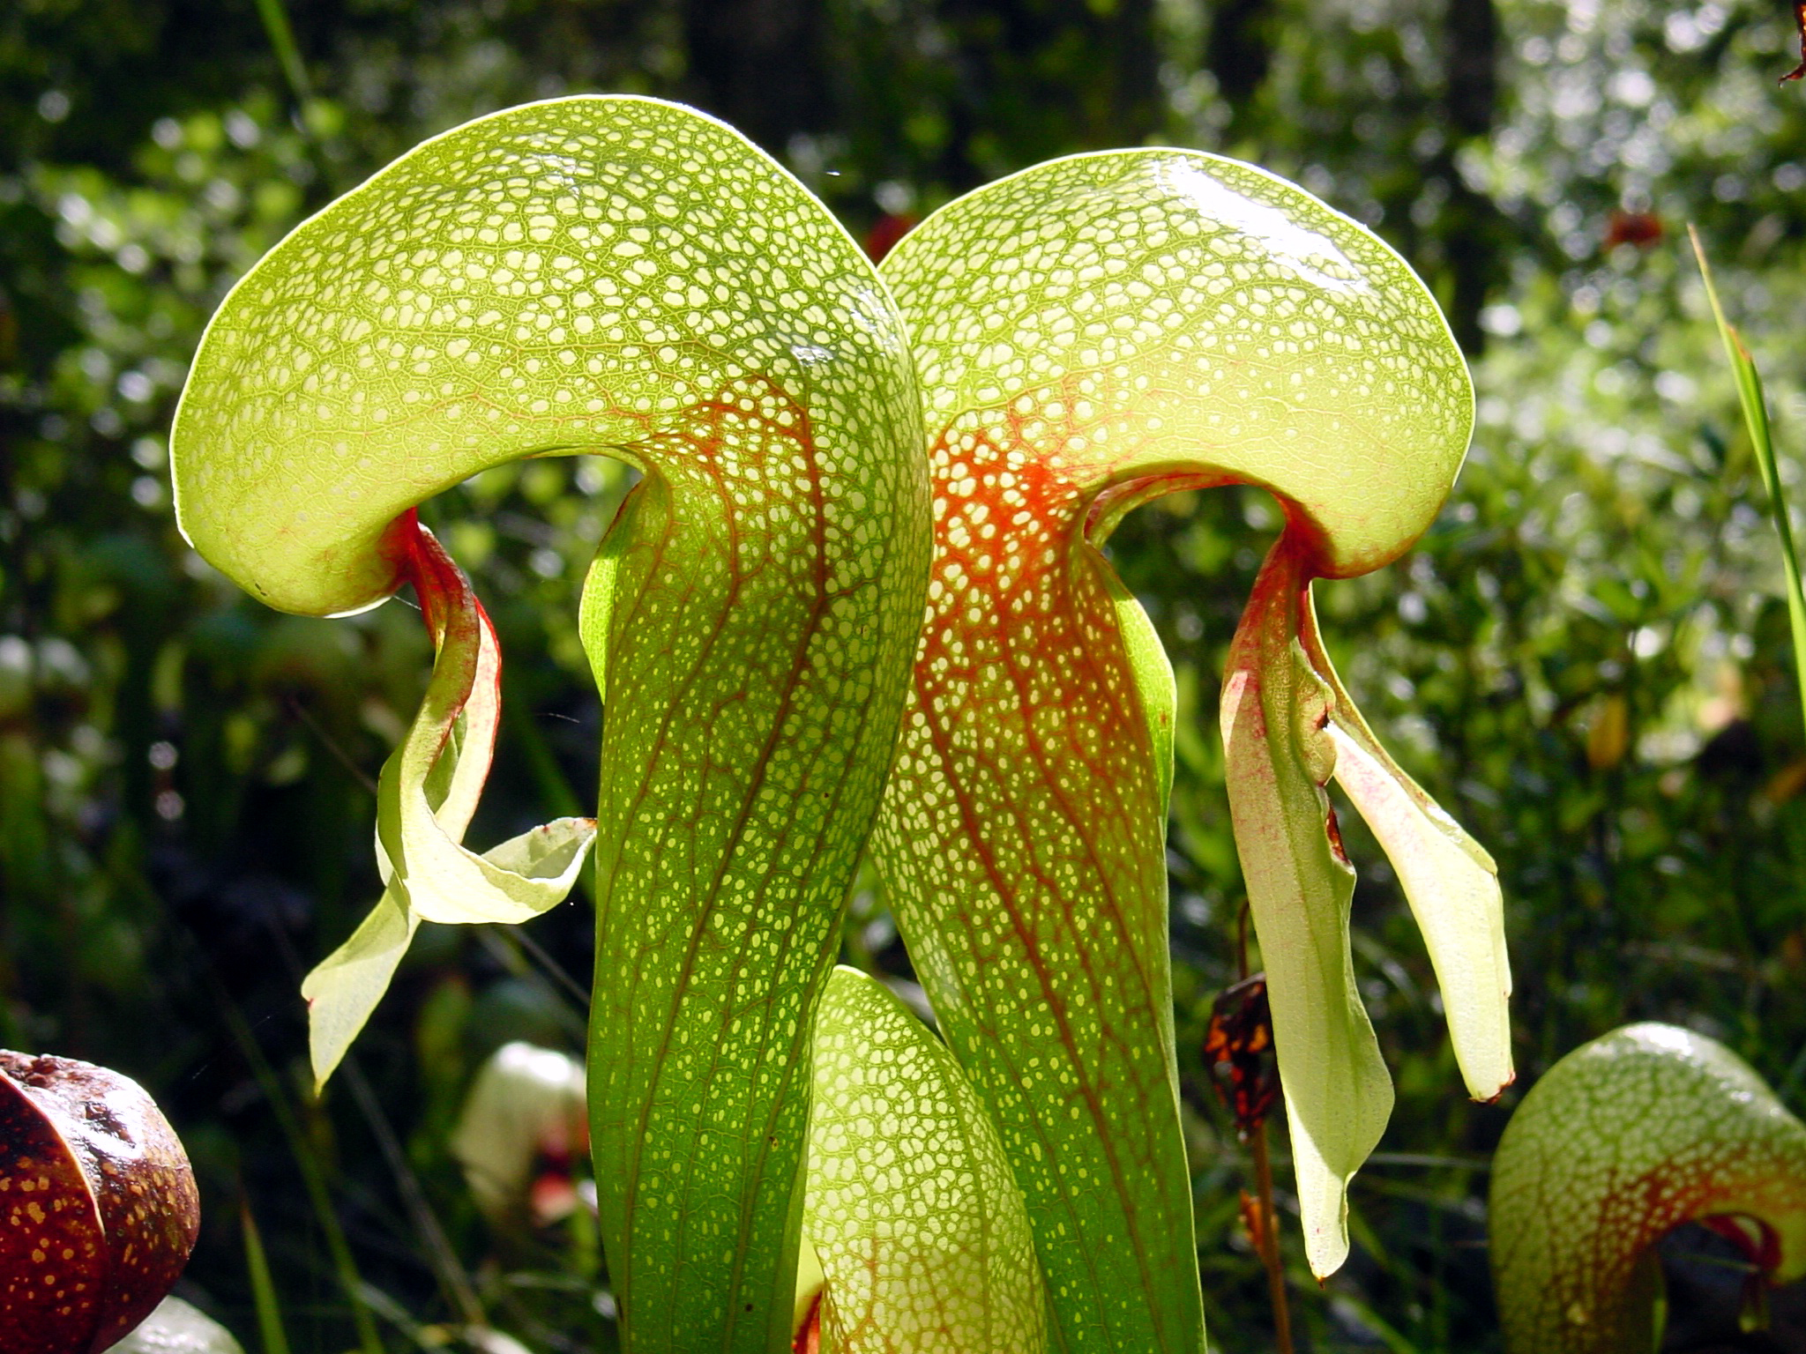
LESSON INFORMATION
Materials:
Visual aids (images, videos) of different carnivorous plant species
Poster paper or digital presentation tools
Internet access for research
Plant specimens (optional)

Slide 5
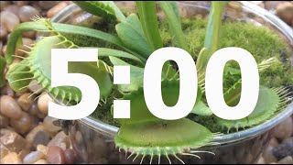
INTRODUCTION
THINK PAIR SHARE
With your shoulder partner:
Discuss what are carnivorous plants,if you have ever heard of carnivorous plants and if so which ones are you aware of.

Slide 6
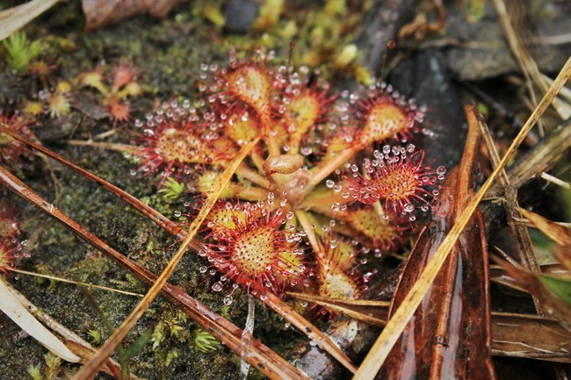
INTRODUCTION
THINK PAIR SHARE
Class share
Notes:
NOTES: Encourage a brief class discussion.
Explain that carnivorous plants are a fascinating group of organisms that have evolved unique adaptations to survive in nutrient-poor environments.

Slide 7
WHAT ARE CARNIVOROUS PLANTS?
Carnivorous plants are plants that derive some or most of their nutrients from trapping and consuming animals, typically insects, and occasionally small mammals and birds.
They still generate all of their energy from photosynthesis

Slide 8
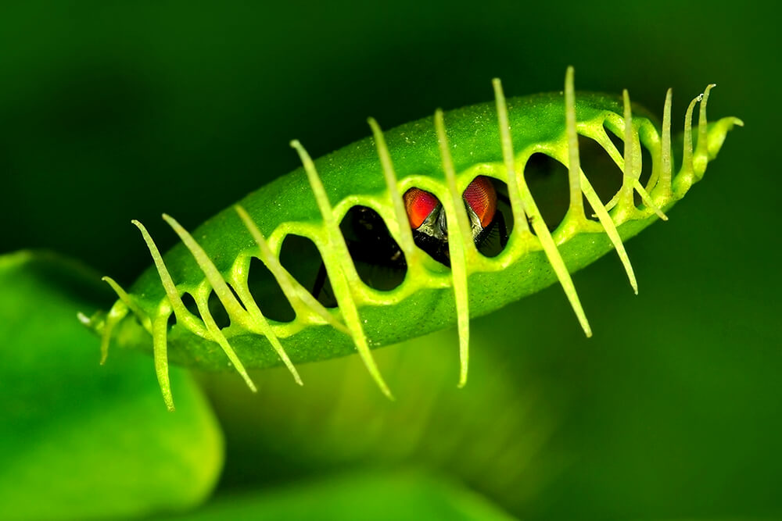
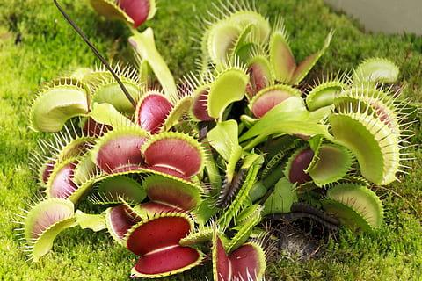
TYPES OF CARNIVOROUS PLANTS
Venus flytrap
When an unsuspecting insect brushes against tiny trigger hairs on a leaf-trap though, the trap snaps shut in less than a second. Once the trap is tightly closed, digestive acids and enzymes dissolve the insect, and the plant absorbs the nutrient-rich "soup." Seven to ten days later, the trap opens, ready for another meal.

Slide 9
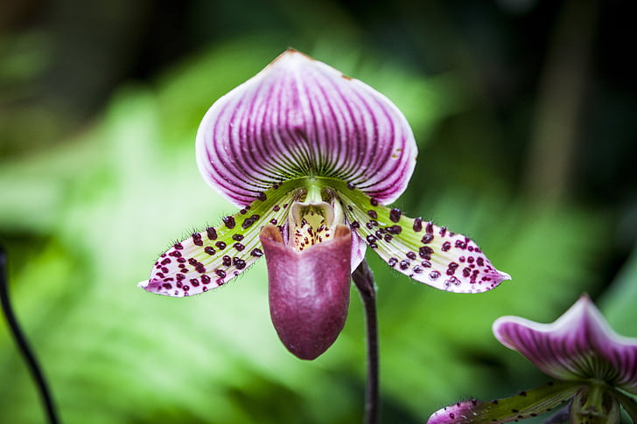
TYPES OF CARNIVOROUS PLANTS
Pitcher plant
Color, nectar, and a delicious scent lure insects into this plant's pitfall trap. Drunk on the plant's intoxicating nectar, an insect slides down into the slippery tube. Downward-pointing hairs within the pitcher ensure that it can't crawl out. At the bottom of the pitcher, a pool of digestive acids and enzymes slowly dissolve the insect's body. The pitcher plant absorbs precious nutrients—nitrates and phosphates—from its prey, which can be ants, flies, wasps, bees, beetles, slugs, and snails.

Slide 10
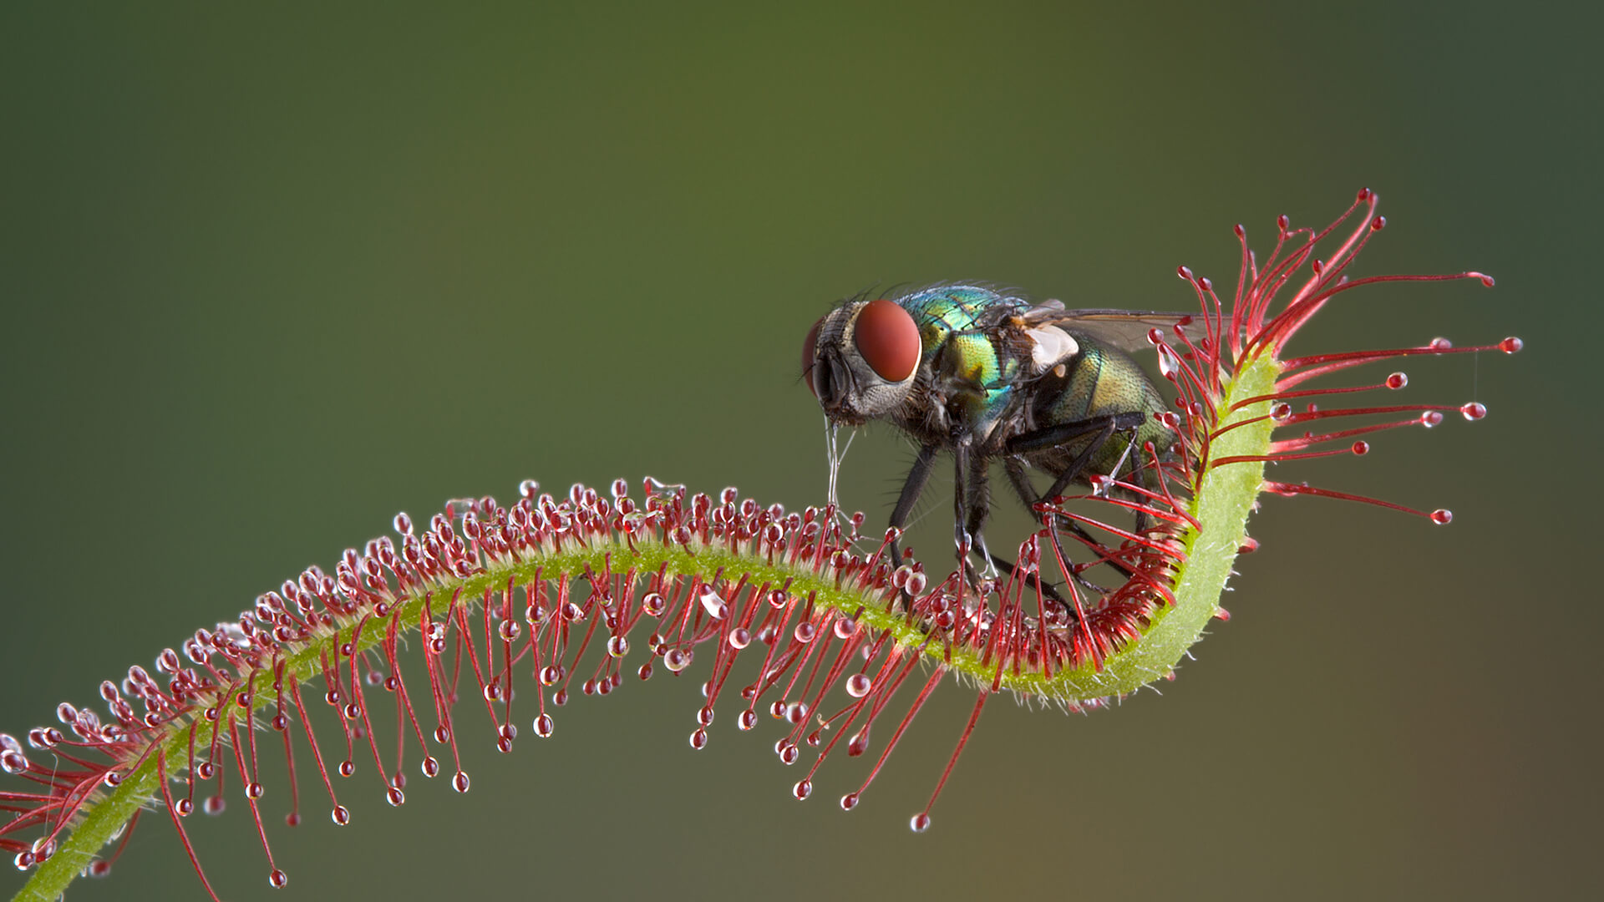
TYPES OF CARNIVOROUS PLANTS
Sundews
Sundews shimmer and glisten as if the sun were glancing off their dew-covered leaves. But that's not dew. The leaves of a sundew are covered with long, nectar-tipped tentacles. This nectar is also a powerful glue, which traps the unfortunate insect that stops for a sip. The struggles of an insect as small as a gnat cause the leaf to slowly curl around its trapped prey. They also cue the leaf to produce digestive enzymes that dissolve the captured insect, and the plant absorbs the liquid, nutrient-rich soup.

Slide 11
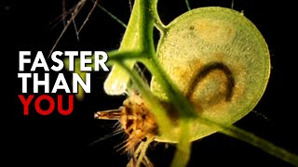
TYPES OF CARNIVOROUS PLANTS
Bladderworts or Utricularia

Slide 12
IT’S YOUR TURN
You have been assigned a group and a plant.
Research your assigned plant's:
Habitat and geographic distribution
Physical characteristics and adaptations
Mechanism of trapping and digesting prey
Nutritional benefits from carnivory
Role in its ecosystem
Notes:
This can also be an assessment.

Slide 13
IT’S YOUR TURN
Compile your research in
Pamphlet
Poster
Article
Flyer
Digital presentation

Slide 14
GALLERY WALK
Display artifacts around the classroom and present any digital presentations

Slide 15
THREATS TO CARNIVOROUS PLANTS
Global climate change
Illegal poaching
Clearing of land for agriculture mining and development

Slide 16
THREATS TO CARNIVOROUS PLANTS
THINK PAIR SHARE
Why do you think carnivorous plants might be more vulnerable to these threats compared to non-carnivorous plants?

Slide 17
THREATS TO CARNIVOROUS PLANTS
THINK PAIR SHARE
Class share
Notes:
NOTES: Encourage a brief class discussion.
Explain that carnivorous plants are a fascinating group of organisms that have evolved unique adaptations to survive in nutrient-poor environments.

Slide 18
IMPORTANCE OF CONSERVATION
Insect Control
Nutrient Cycling
Notes:
NOTES: Encourage a brief class discussion.
Explain that carnivorous plants are a fascinating group of organisms that have evolved unique adaptations to survive in nutrient-poor environments.

Slide 19
IMPORTANCE OF CONSERVATION
CLASS DISCUSSION
Discuss how the loss of carnivorous plants could impact local ecosystems.
Notes:
NOTES: Encourage a brief class discussion.
Explain that carnivorous plants are a fascinating group of organisms that have evolved unique adaptations to survive in nutrient-poor environments.

Slide 20
CONSERVATION STRATEGIES
Introduce different conservation strategies being employed to protect carnivorous plants, including habitat preservation, reintroduction programs, and public awareness campaigns.
Show examples of successful conservation efforts and their outcomes.
Notes:
NOTES: Encourage a brief class discussion.
Explain that carnivorous plants are a fascinating group of organisms that have evolved unique adaptations to survive in nutrient-poor environments.

Slide 21
IT’S YOUR TURN
You have been assigned a group and a specific carnivorous species facing conservation challenge.
Brainstorm and discuss potential conservation strategies and present to the class.
Notes:
This can also be an assessment.

Slide 22
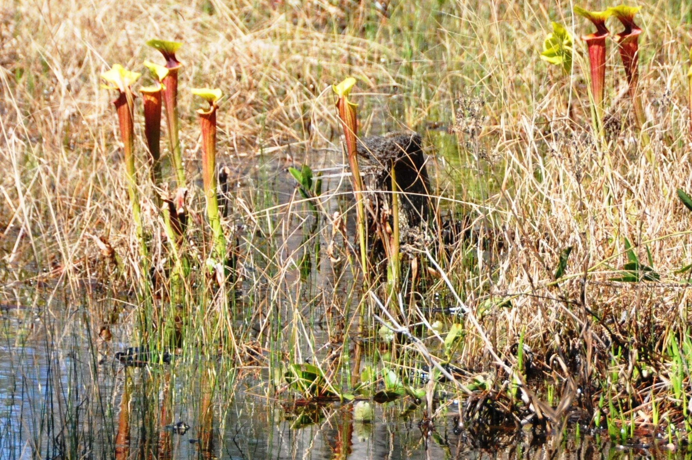
DISCUSSION AND ANALYSIS
What do we know?
Notes:
Bring the class back together for a group discussion on the ecological significance of carnivorous plants.
Discuss how these plants contribute to their ecosystems by supplementing their nutrient intake, especially in nutrient-poor environments.
Explore potential impacts of human activities, such as habitat destruction, on carnivorous plant populations.

Slide 23
DISCUSSION AND ANALYSIS
What are the ethical considerations of cultivating carnivorous plants as ornamental plants or for educational purposes.
How does human activity and habitat loss impact carnivorous plant populations, focusing on specific examples from different regions.
What would happen in an ecosystem where carnivorous plants are a dominant species, considering their interactions with other organisms and their effects on the food web.
Notes:
Bring the class back together for a group discussion on the ecological significance of carnivorous plants.
Discuss how these plants contribute to their ecosystems by supplementing their nutrient intake, especially in nutrient-poor environments.
Explore potential impacts of human activities, such as habitat destruction, on carnivorous plant populations.

Slide 24
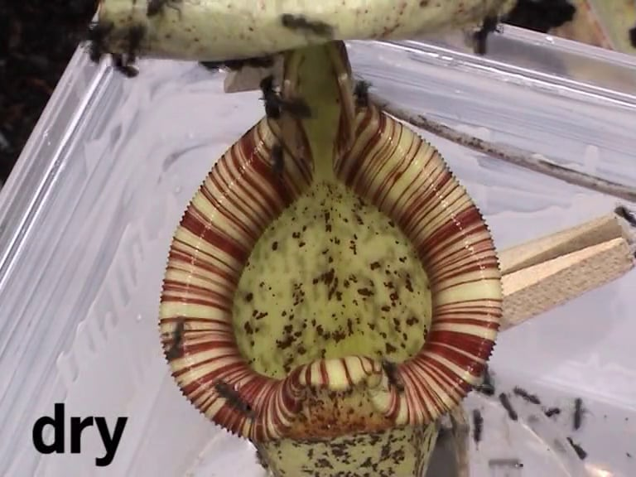
CONCLUSION
What have we learned?
Notes:
Summarize the key points of the lesson and emphasize the extraordinary adaptations of carnivorous plants.
Encourage students to continue exploring and appreciating the diversity of life on Earth, including unique and specialized organisms like carnivorous plants.

