Slide 1
Carnivorous Plants
Explore the world of
A Digital Media
Research Project

Slide 2
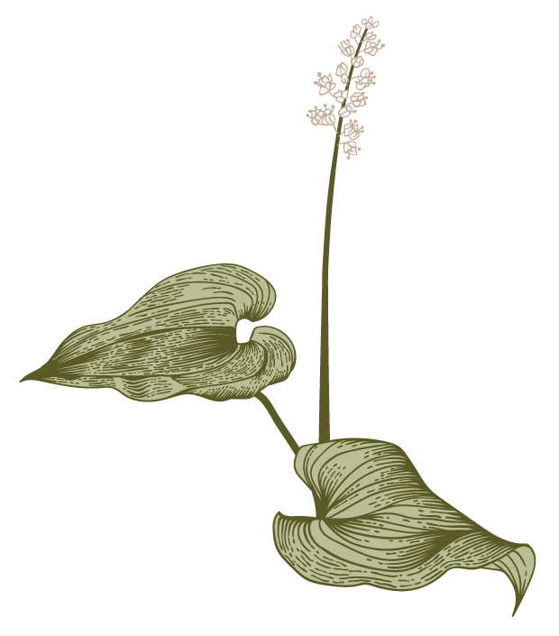
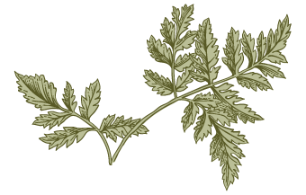
Unit Outline
CP
Part 1
What is a Carnivorous Plant? - Venn
Part 2
Digging Deeper – Treasure Map
Part 3
Pollinators vs Prey - Postcard
Part 4
Culminating Video Project Instructions

Slide 3
What is a Carnivorous Plant?
https://youtu.be/lXRIaigt2yQ
After viewing the video and answering the questions, select at least 2 additional print resources from the classroom library to continue your research. For this step, focus on discovering what a carnivorous plant IS and how it differs from the plants we have growing in our classroom and greenhouse.
Complete a Venn Diagram that identifying at least 8 traits based on your research.
Notes:
SC.5.L.14.2Compare and contrast the function of organs and other physical structures of plants and animals, including humans, for example: some animals have skeletons for support -- some with internal skeletons others with exoskeletons -- while some plants have stems for support. (DOK 2)
SC.5.L.15.1Describe how, when the environment changes, differences between individuals allow some plants and animals to survive and reproduce while others die or move to new locations. (DOK 3)
SC.5.L.17.1Compare and contrast adaptations displayed by animals and plants that enable them to survive in different environments such as life cycles variations, animal behaviors and physical characteristics. (DOK 2)

Slide 4
Digging Deeper
Continue researching and create a Carnivorous Plants U.S. Treasure Hunt Map.
It should tell “hunters” where to find at least 6 different types of carnivorous plants.
Include a detailed diagram of the plant so they will know it when they locate it.
Notes:
This part of the project can be completed using any Stopmotion animation app for iPad. Students at my school typically use Stopmotion Explosion or Final Cut ProX.

Slide 5
WAIT! What about Pollinators?
We have learned the importance of pollinators in the life cycles of plants. Imagine you are a honey bee that is looking for food in an ecosystem that has carnivorous plants! DANGER!!!!
Read the links below to find out how carnivorous plants have adapted to be sure they don’t remove all the pollinators from an area.
Write a Warning Postcard from one honey bee to another hive warning them of the dangerous plants you have discovered. Give lots of details and descriptions to help keep them safe!
https://www.si.edu/stories/how-carnivorous-plants-avoid-eating-their-pollinating-insect-friends
https://www.nature.com/articles/srep21065

Slide 6
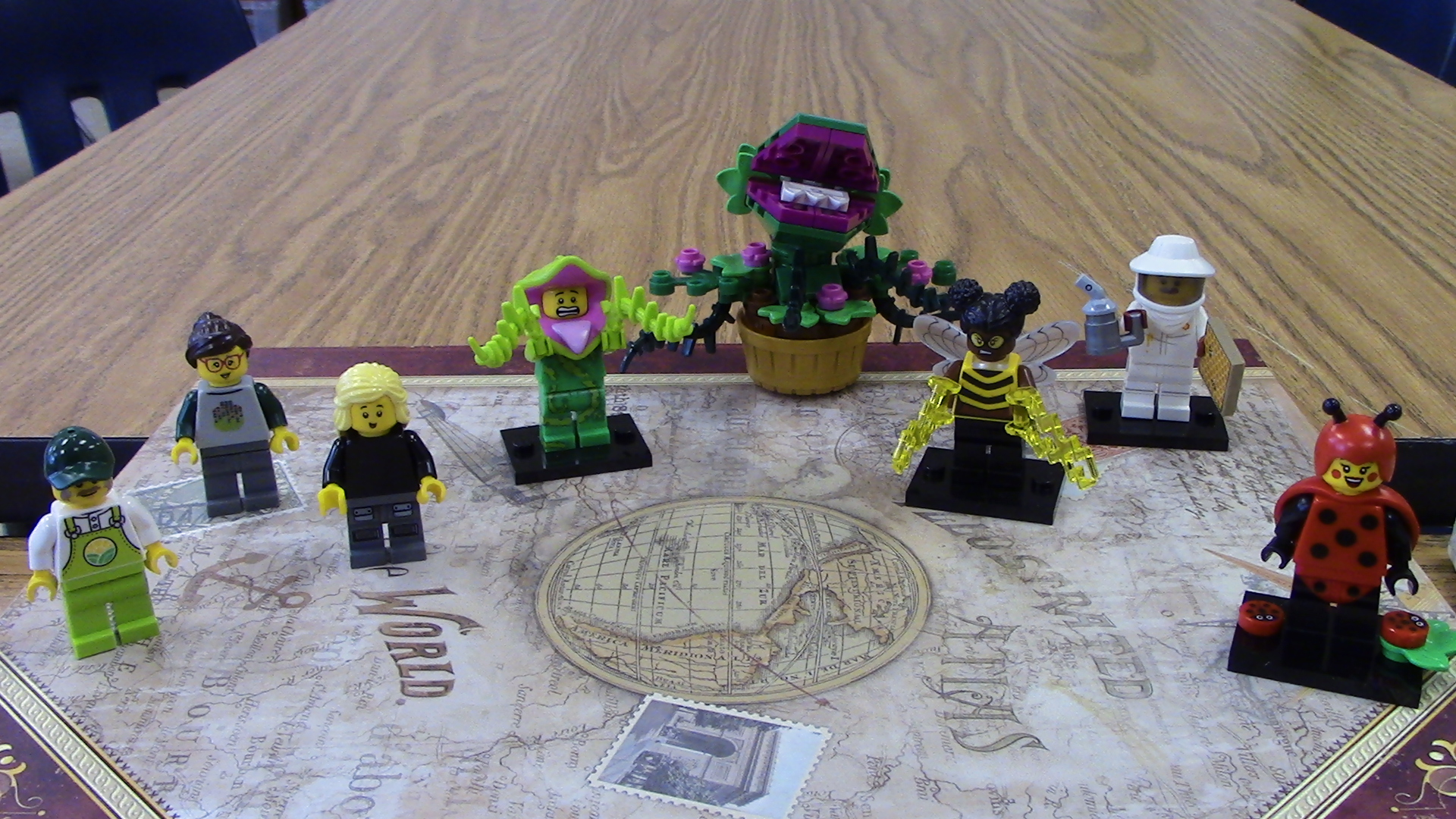
Carnivorous Plant Video Project
To show off your new understanding of Carnivorous Plants, work with a partner to create a stop motion animation that has an exciting plot AND shares facts you learned.
(Similar to a Magic School bus video)
Choose at least 3 characters from the choices on the next slide.
Create a storyboard with at least 4 scenes and write a script of dialog FULL of facts and fun, follow logical story sequence.
Complete your animation, making SURE to use the Project Rubric as a guide.

Slide 7
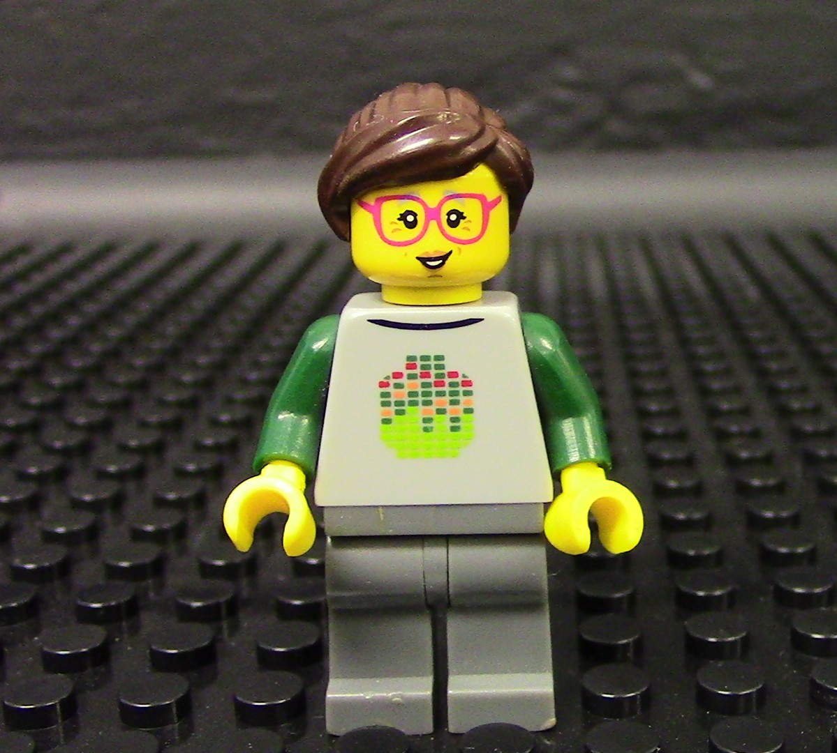
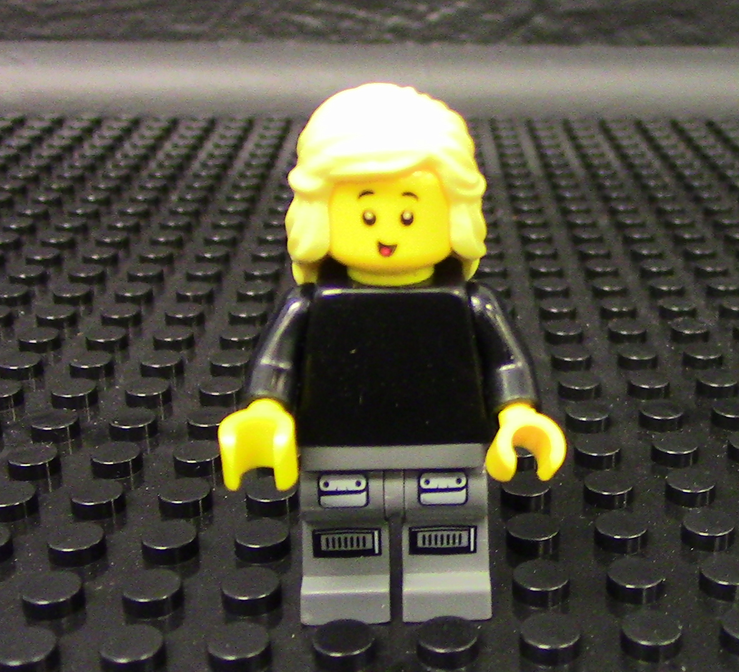
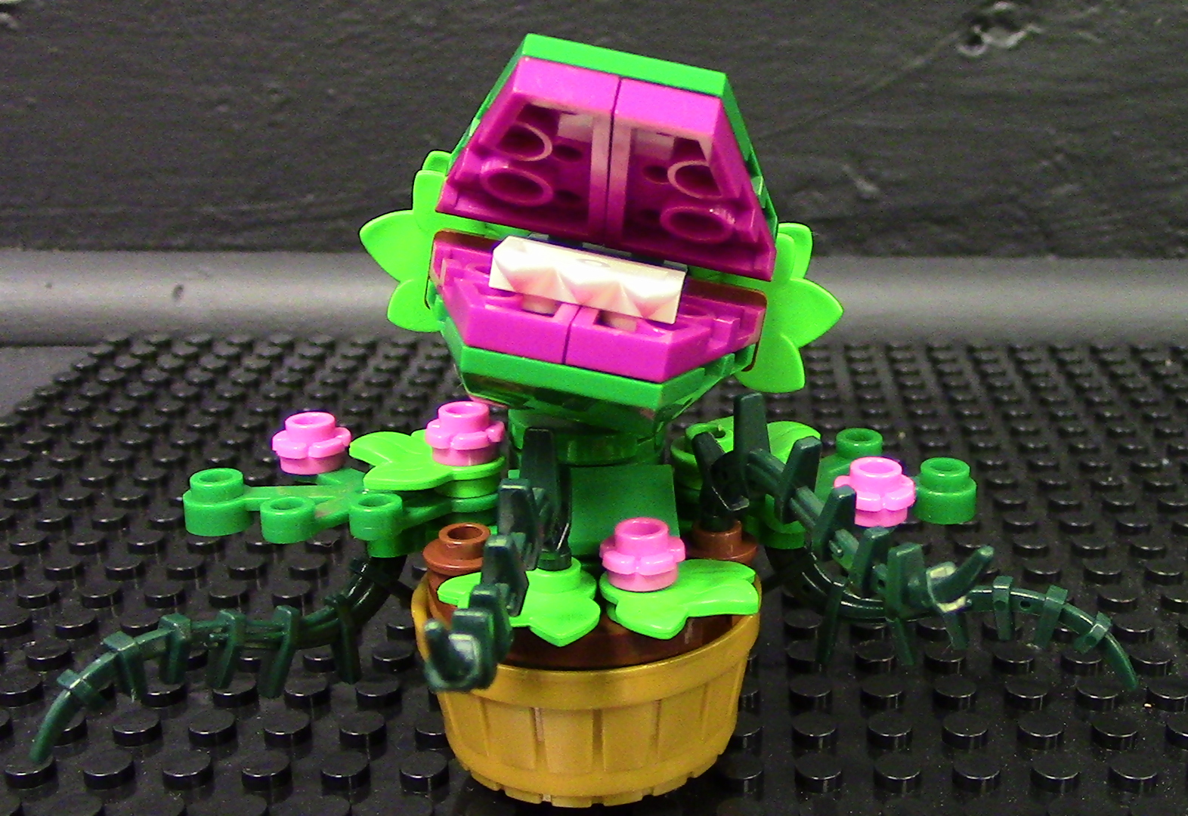
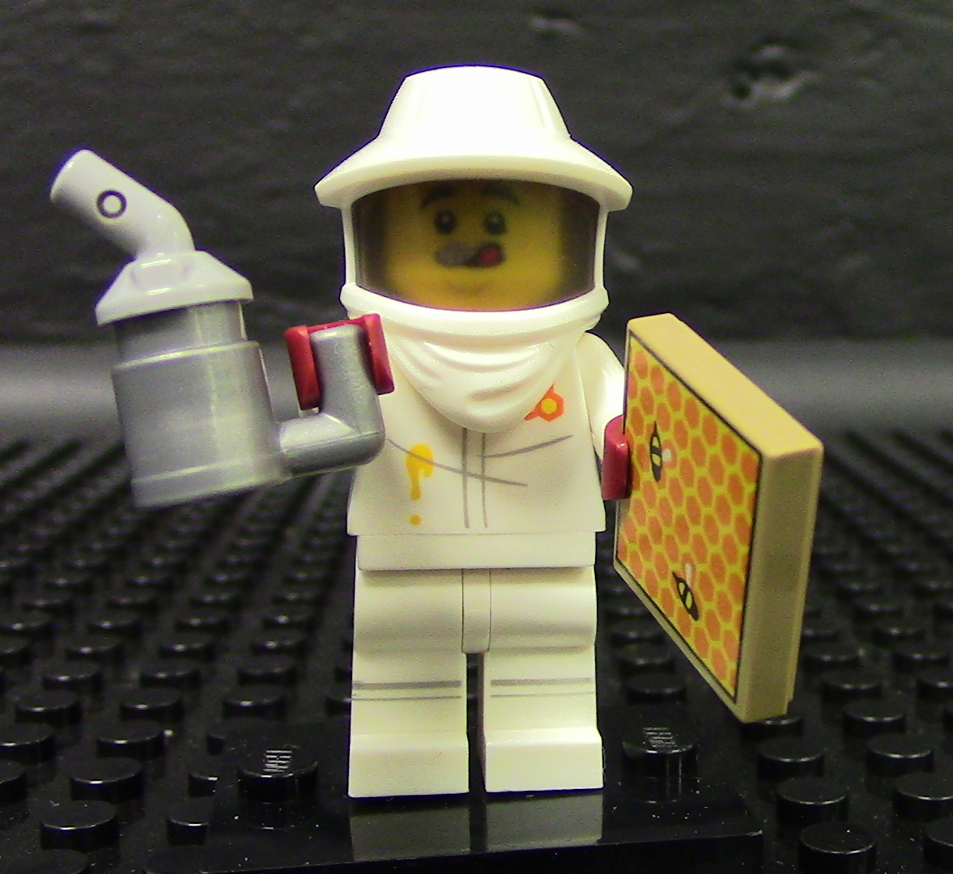
Choose Your Characters
Lae Dee Bug
Mrs. Cayer​
Mrs. Selfridge
Hun E. Bee
Pollinator and Aphid muncher
Advanced Science Teacher
Advanced Science Teacher
Pollinator and Dance Teacher
Farmer Fred
Vinny Venus
Big Trouble
Cultivator and Dirt Expert
Person? Plant? Both?
You Decide!
With Really, BIG teeth!
Beekeeper Brad
Awesome Apiarist

Slide 8
Carnivorous Plant Video Project Rubric
 | 4 -5 Points | 2-3 points | 1 point | 0 points
Fascinating Facts | 8-10 or complete facts integrated into the video | 4 – 7 research-based facts, most are complete, and integration into story was attempted | 1-3 research-based facts, some may be incomplete | No facts from research
Creative Storytelling | Story is entertaining and follows logical rising action sequence with clear details. | Story has a complete simple structure with some extra elements | Story has an attempt at structure but is incomplete or confusing | Story has no structure or logical sequence
Interesting Characters | Characters are developed and interesting, actions and dialogue match their planned personality. | Basic characters established, may lack detail or background. Dialog is simple or lacking in detail | Characters introduced simply with no elaboration or not explained | No character development
Technology Skills | Proper framing, Filming minimized flicker Clear sound, sound effects and music add to the story | Acceptable framing Correctly filmed animation Acceptable sound Some music and sound effects added. | Incorrect framing Minimal animation attempted Poor video or sound Little to no effects added | No animation/movement No sound No sound effects

Slide 9
Carnivorous Plant Video Project Checklist
Present your video to the group
What is a Carnivorous Plant?
Complete Venn Diagram
Digging Deeper
Complete Treasure Map
What about Pollinators
Bee’s Warning Postcard
Stop Motion Video Project
Create a video story teaching what you learned about Carnivorous Plants
Show Off Day!
Color each point on the number line as you complete the task!

Slide 10
Thank you
Jennifer Cayer
Southwest Elementary School
Southwest Digital Media Academy
jennifer.cayer@polk-fl.net

Slide 11
Venn Diagram

Slide 13
Pollinator Postcard Warning

