Slide 1
Carnivorous Plants
Nature’s Predators
Notes:
- Do a quick Q&A on carnivorous plants, ask students what they know about them and if they’ve ever seen one in person.
Movies where they made an appearance: Little Shop of Horrors, Addams Family, Jumanji, Emperor’s New Groove,
Pokemon: Victreebell
Video Game: Skyrim, on the island of Wyrmstooth

Slide 2
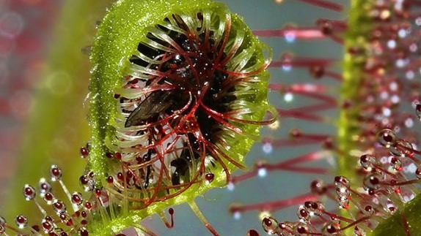
Criteria
Capture prey in traps.
Kill the captured prey.
Digest the captured prey.
Absorb nutrients from the killed and digested prey.
Use those nutrients to grow and develop.
Notes:
What makes a carnivorous plant, carnivorous?
They DO photosynthesize but the majority of their nutrients comes from the prey they catch.
They must meet the FIVE criteria to be classified as carnivorous.
Inform the students that there are other plants that may meet one or more of the criteria but because they don’t meet the 5, they cannot be classified as “carnivorous”.
Ask students for examples of prey. (insects, small vertebrae, small rodents, frogs, etc.)

Slide 3
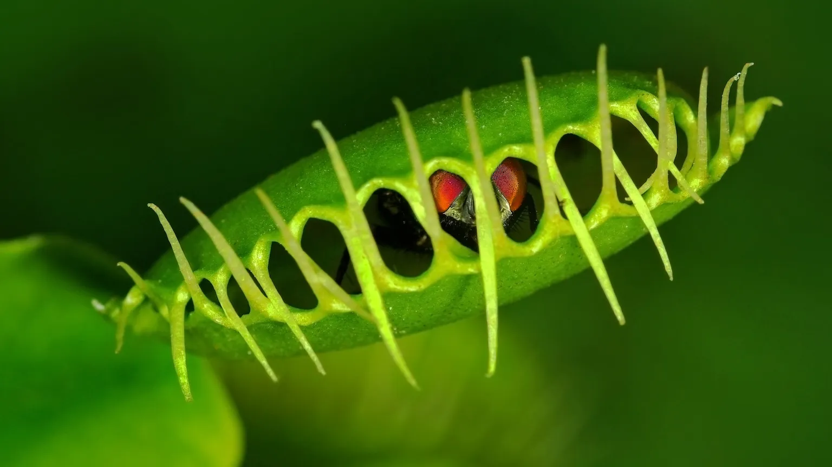
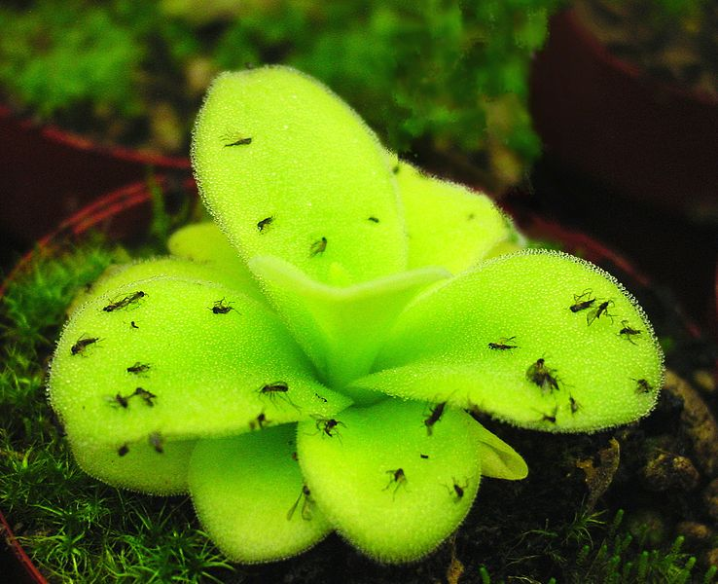
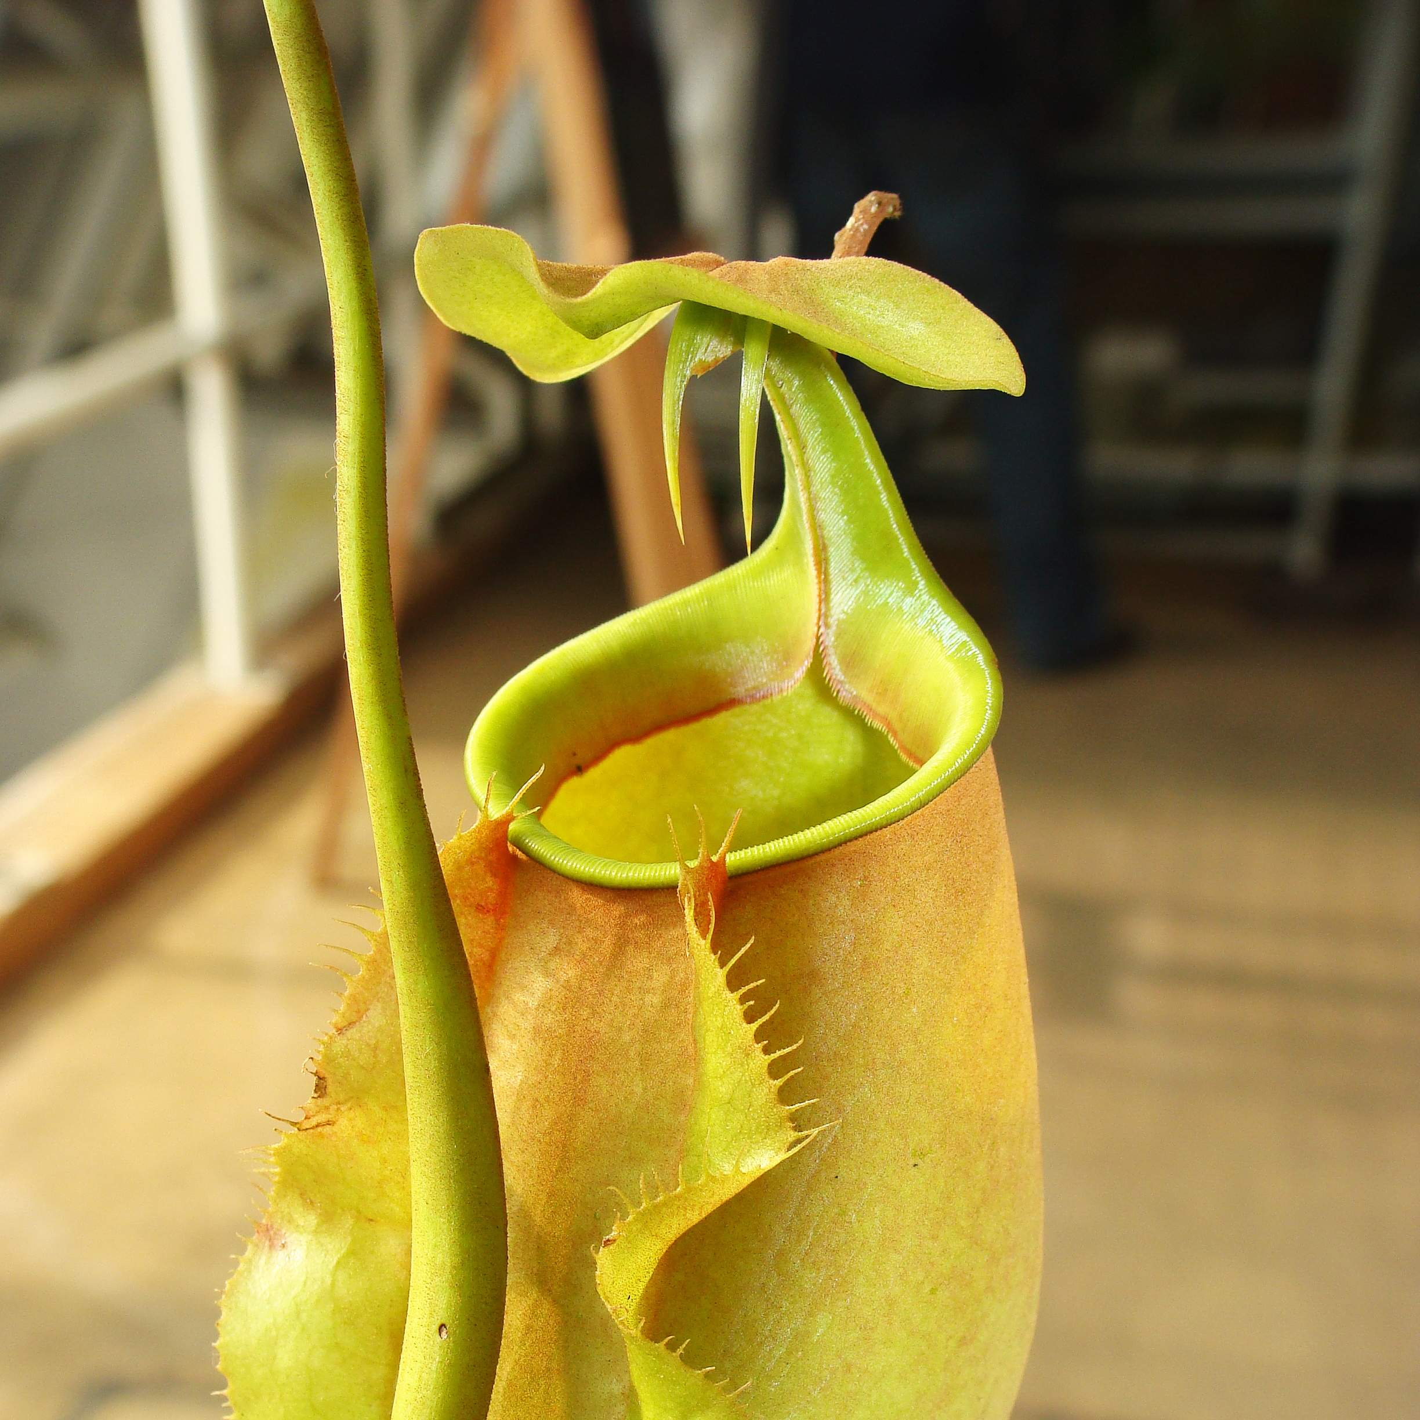
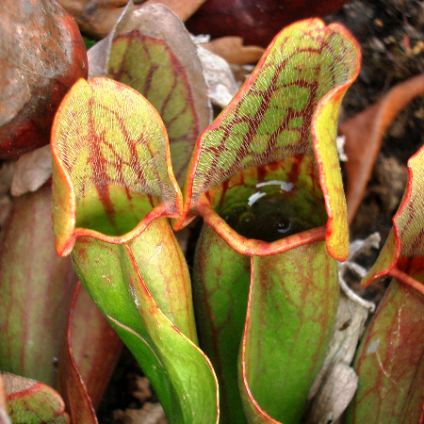
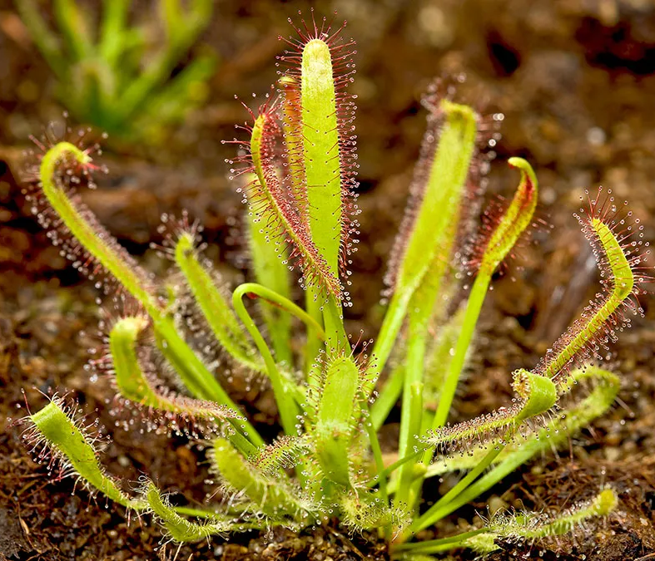
Varieties
Venus Fly Traps
Sarracenia
Nepenthes
Sundews
Butterworts
Utricularia
Notes:
There are over 750 recognized carnivorous plant species in the world in various sizes.
These are some of the most recognized ones, each with unique methods of catching prey.

Slide 4
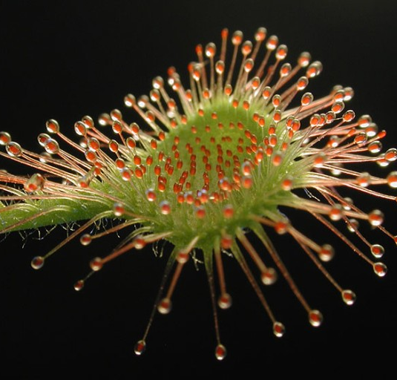
Adaptations
Traps
Tall Flowers (to save pollinators)
Digestive enzymes
Ability to attract prey
Survive in nutrient deficient environments
Notes:
Driving force for evolution: they need to find an alternative source of vital nutrients.
Types of traps:
Pitfall traps of pitcher plants are leaves folded into deep, slippery pools filled with digestive enzymes. Flypaper (or sticky or adhesive traps) of sundews and butterworts are leaves covered in stalked glands that exude sticky mucilage. Snap traps (or steel traps) of the Venus flytrap and waterwheel plant are hinged leaves that snap shut when trigger hairs are touched. Suction traps, unique to bladderworts, are highly modified leaves in the shape of a bladder with a hinged door lined with trigger hairs. Lobster-pot traps of corkscrew plants are twisted tubular channels lined with hairs and glands.
They don’t want to accidentally eat their pollinators; the flowers carnivorous plants produce are super long and away from traps.
Plants might produce nectar as a lure, or an attractive smell.
Some plants have visual appeal that humans can only see in UV light.
Because they get their nutrients from prey, they can live in places with little nutrients in the soil. They tend to have small hair-like roots since the roots don’t play as big of a role as they do in non-carnivorous plants’ lives.
Background picture: Close up of a round-leaved sundew.

Slide 5
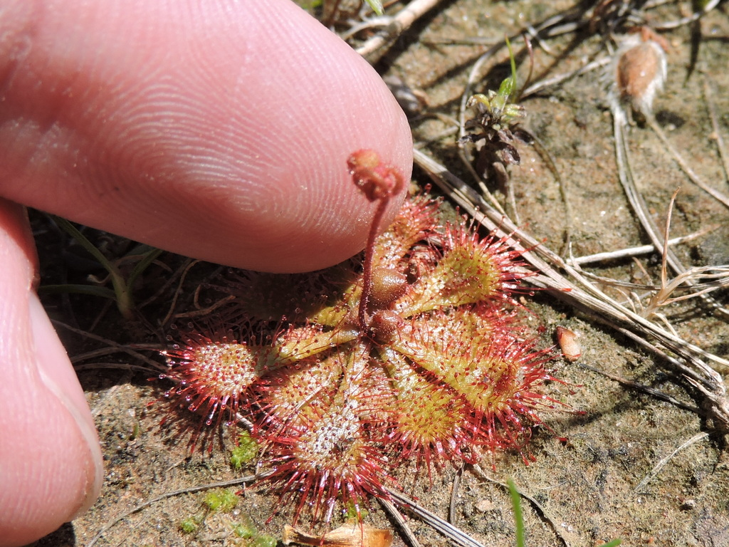
Nepenthes Rajah
Dwarf Red Sundew
Endemic to Borneo (Malaysia)
Pitchers Capable of holding 118oz. of water and >80oz. of digestive fluid
Endemic to US (South Eastern US)
No more than 3cm across
Notes:
Sizes differ in plants, for example:
- Nepenthes Rajah is one of the largest carnivorous plants-
- Sundew is one of the smallest (and local to us here in the US)

Slide 6
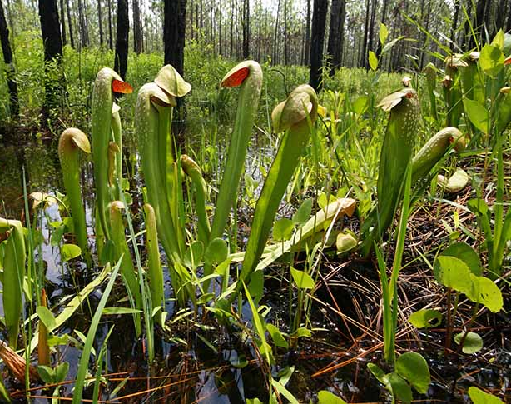
Habitat
Bogs
Swamps
Forests
Sandy/Rocky sites
Many are native to North America:
Alabama
Florida
Georgia
Illinois
Mississippi
New Jersey
North Carolina
Oregon
Notes:
- Mainly found in Nutrient poor wetlands
- Many are found in US, even here in Central Florida.
- Other places include Australia, Malaysia, Indonesia, N. Africa, Central and South America, and Europe.

Slide 7
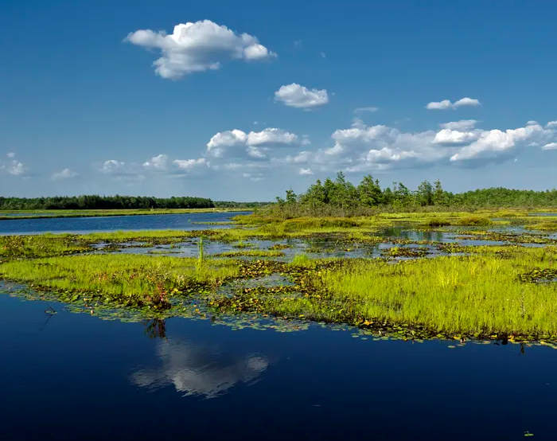
Conservation
Many carnivorous plant species across the world may be at risk of extinction due to global climate change, illegal poaching, and the clearing of land for agriculture, mining and development.
We can combat that through:
Prescribed Burns
Education (Preserve Studies)
Redistribution of ethically grown plants
Habitat Conservation Initiatives
Notes:
Discuss importance of prescribed burns: Prescribed burning uses periodic fires to limit growth of shrubs. With fire eliminating the competition, the carnivorous plants and flourish in the abundant sunlight.
Discuss poaching and ethics involved.
Introduce International Carnivorous Plant Society- an organization of horticulturists, conservationists, scientists, and educators all interested in sharing knowledge and news of carnivorous plants.

Slide 8
Notes:
Have Students Complete Worksheet “What are carnivorous Plants”

Slide 9
References
https://www.carnivorousplants.org/education
https://www.nhm.ac.uk/discover/carnivorous-plants-meat-eaters-of-the-plant-world.html#:~:text=Most%20carnivorous%20plants%20produce%20digestive,down%20their%20catch%20for%20them.
https://www.slideshare.net/MuhammadSaleh9/carnivorous-plants-ppt-les-3
https://www.sarracenia.com/faq/faq1045.html#:~:text=The%20plant%20must%20have%20clear,hairs%20that%20guide%20prey%2C%20etc.
https://www.worldwildlife.org/magazine/issues/fall-2020/articles/tropical-pitcher-plants-are-beautiful-but-deadly
https://www.cs.mcgill.ca/~rwest/wikispeedia/wpcd/wp/n/Nepenthes_rajah.htm
https://www.mysabah.com/wordpress/biggest-pitcher-plant-in-the-world/
https://www.inaturalist.org/guide_taxa/987598#:~:text=Drosera%20brevifolia%20(the%20dwarf%2C%20small,native%20to%20the%20United%20States.
https://mediahub.unc.edu/venus-flytrap-burned-not-burnt/

