Slide 1
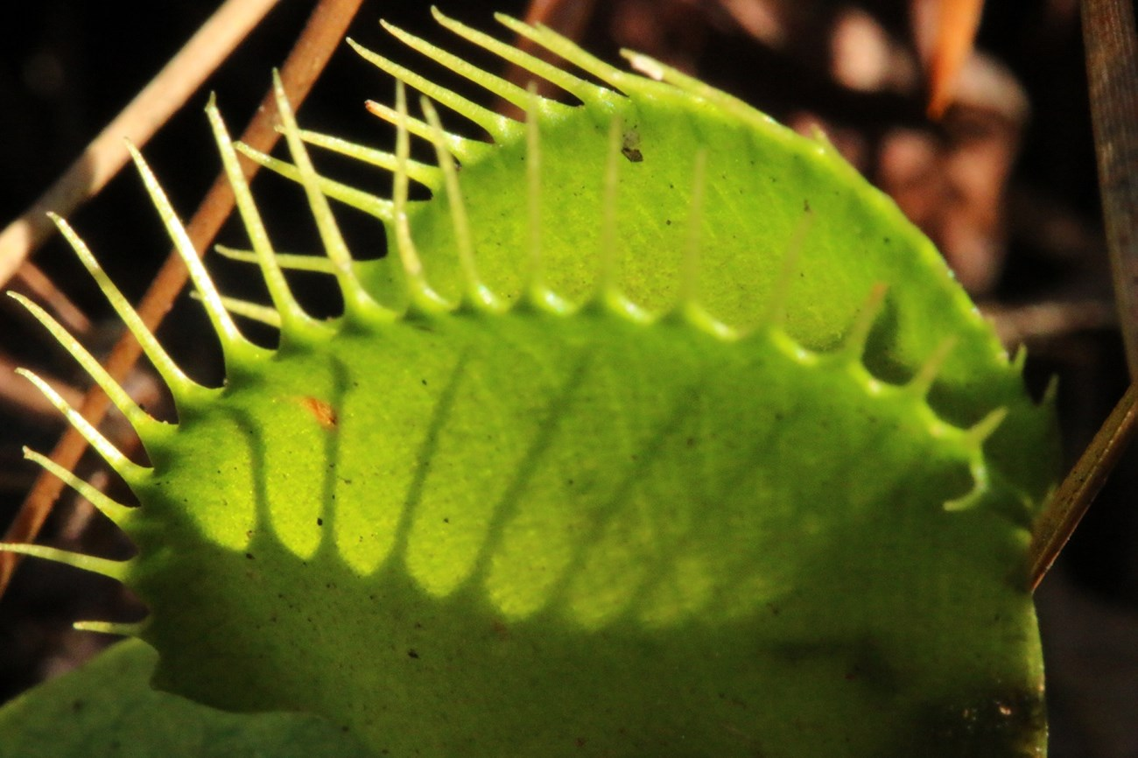
Exploring Photosynthesis & Evolutionary Adaptations
Using Carnivorous Plants
in AP Biology
Diane Pintavalle
Glastonbury High School
Glastonbury, CT

Slide 2
Grade Level: High School AP Biology
Learning Objectives:
By the end of this lesson, students will be able to:
Explain the process of photosynthesis and its importance in energy transfer and the carbon cycle.
Analyze the evolutionary adaptations of plants, focusing on specific examples.
Describe the unique adaptations of carnivorous plants
Evaluate the ecological significance of carnivorous plants
Design and carry out an experiment using carnivorous plants

Slide 3
Day 1: Photosynthesis
Introduction
Begin with a brief discussion of the importance of photosynthesis in the context of energy transfer and the carbon cycle.
Discuss that plants have evolved various strategies to maximize their survival and success.
Photosynthesis Overview
Define photosynthesis and its two main stages: the light-dependent reactions and the Calvin cycle.
Discuss the role of chloroplasts, pigments, and sunlight in photosynthesis.
Students use molecular models to learn and understand energy flow during the light-dependent reactions and the Calvin cycle.

Slide 4
Day 2 Evolutionary Adaptations in Plants
Introduce the concept of adaptation in the context of evolution.
Observe and identify various plant adaptations including structural adaptations such as plants with modified leaves, stems and roots.
Discuss physiological adaptations such as C4 and CAM photosynthesis.
Present specific examples like xerophytes and hydrophytes.

Slide 5
Day 3: Carnivorous Plants and Their Unique Adaptations
Introduction to Carnivorous Plants (10 minutes)
Begin by discussing the concept of carnivorous plants and their unique adaptations.
Ask students if they can name any carnivorous plant species.
Observation and interaction with Carnivorous Plant Species
Explain the different types of traps used by carnivorous plants such as pitfall traps, sticky traps and snap traps.
Present examples such as the Venus flytrap, sundew, and pitcher plant.
Discuss the evolutionary advantages and trade-offs of being carnivorous.
Allow students to observe and interact with actual specimens of carnivorous plants.

Slide 6
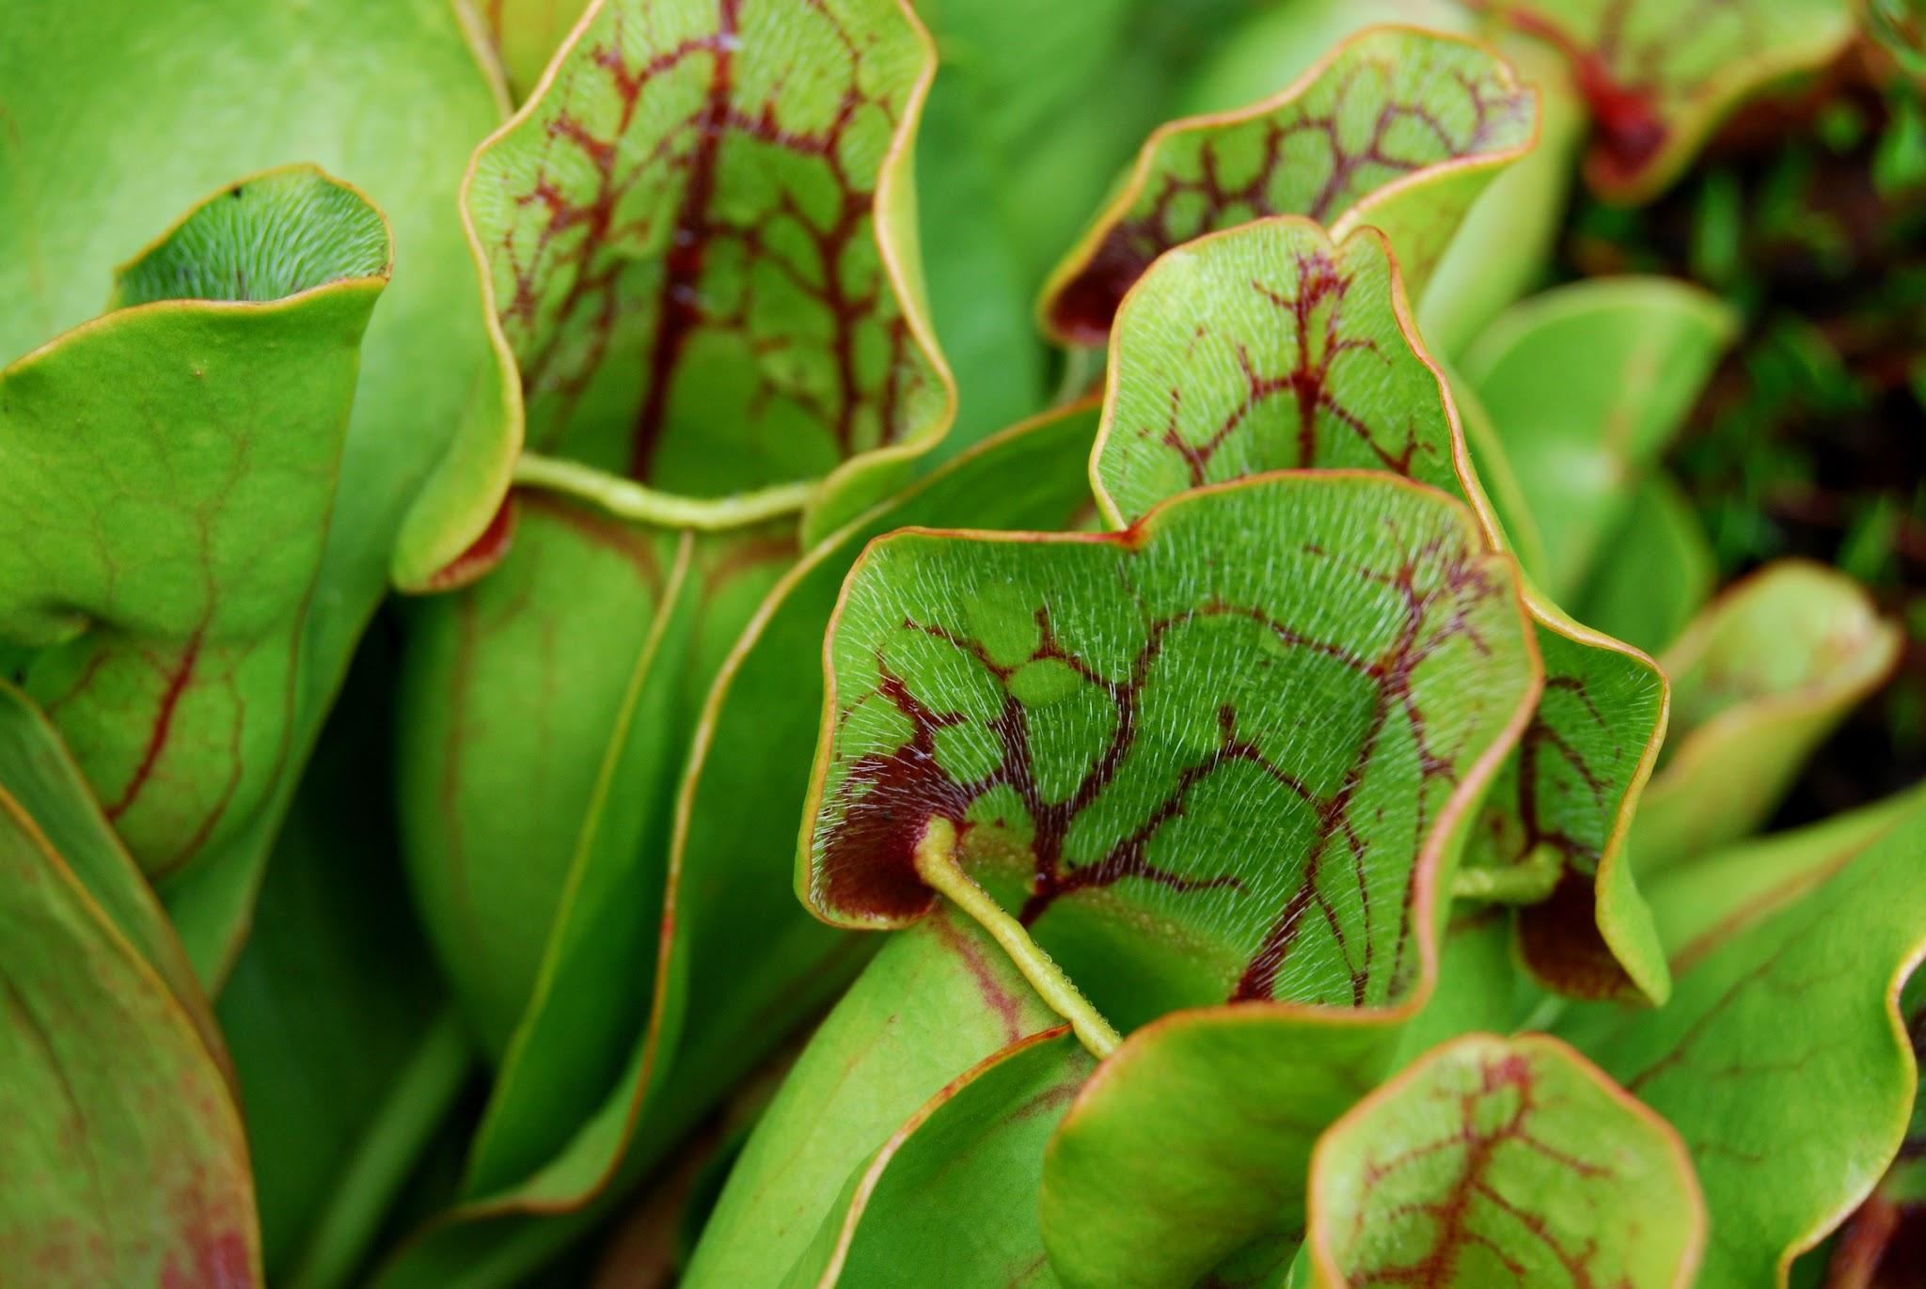
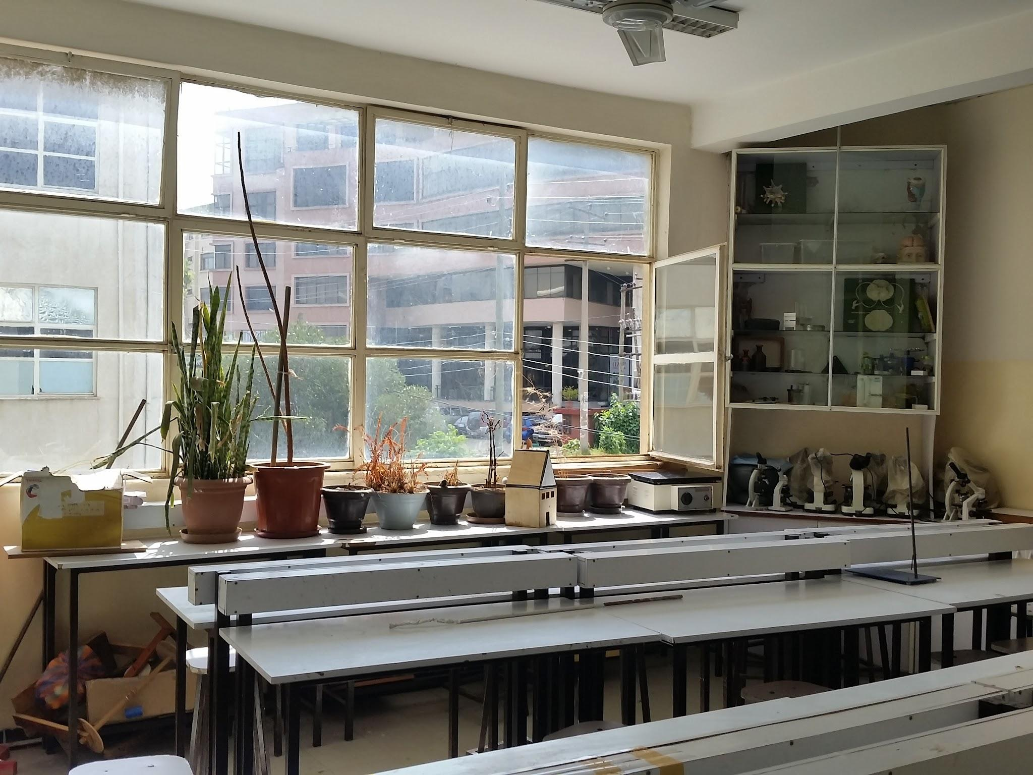
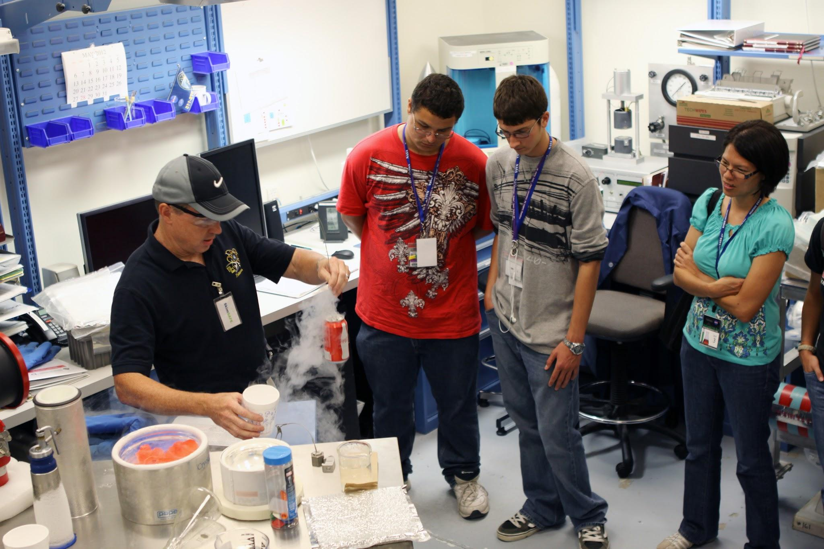
Culminating Activity:
Design a Carnivorous Plant Investigation
Students design a short investigation using carnivorous plants as the focus of their investigation. Topic ideas on following slides.

Slide 7
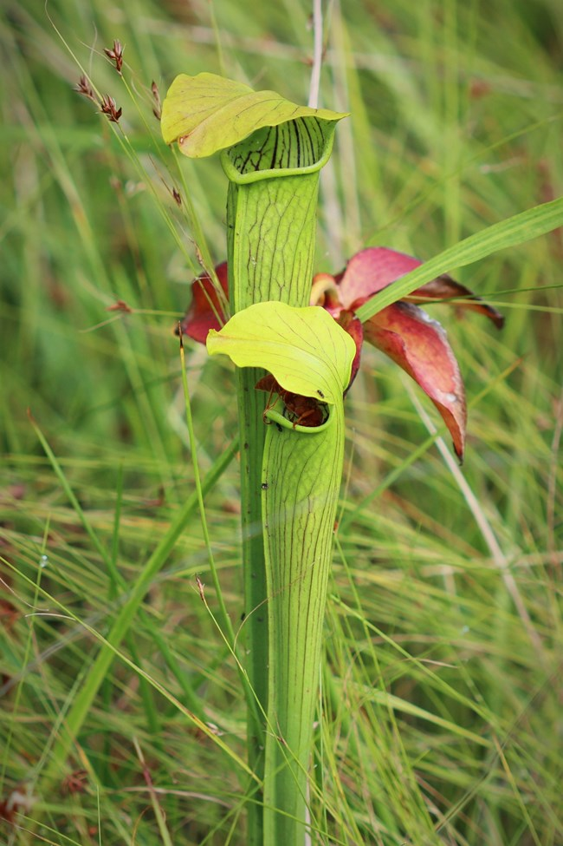
Comparison of the digestive enzymes produced by different types of carnivorous plants

Slide 8
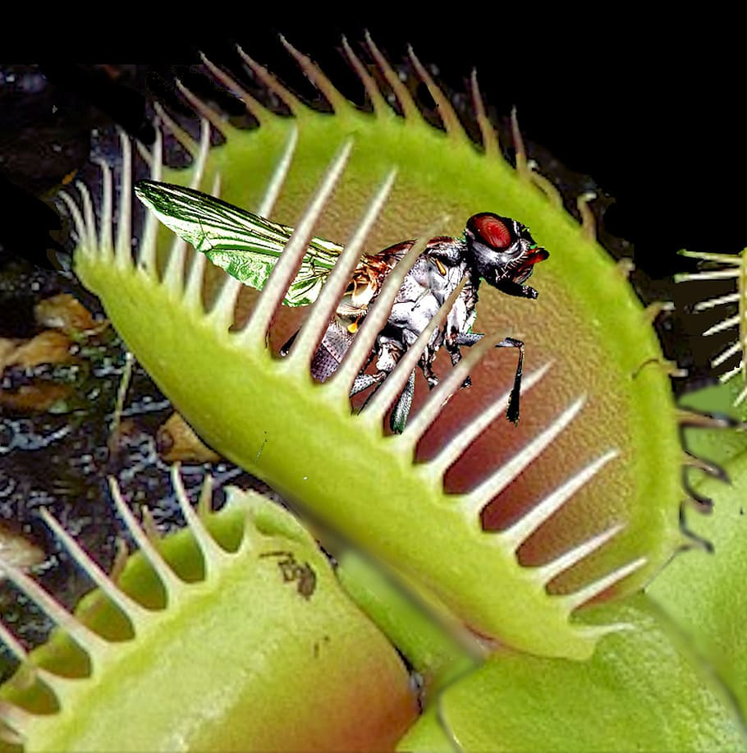
Investigating how nutrient availability (bugs/no bugs) affects the growth and development of various carnivorous plant species.

Slide 9
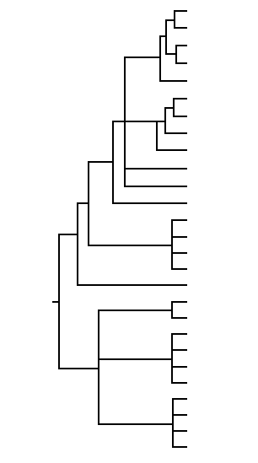
Creation of a phylogenetic tree to show relatedness among a collection of carnivorous plants based on characteristics of students’ choice: physical traits/types of traps/preferred prey

Slide 10
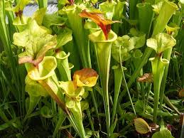
Effect of light (wavelength/number of hours/brightness) on feeding activity of carnivorous plants.

