Slide 1
The Amazing World of
Carnivorous Plants

Slide 2
What do plants need to grow?
Notes:
For the most part, all the plants on earth need the same things: sunlight, water, and carbon dioxide. Through the process of photosynthesis, plants make sugar and oxygen.

Slide 3
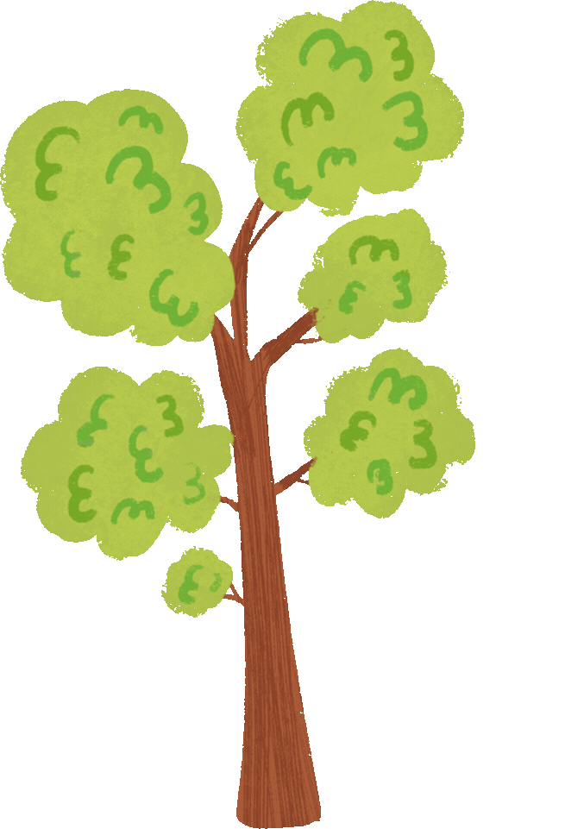
That's not all!
Notes:
Plants have additional needs that are specific to the type of plant! Most plants require nitrogen. If the soil lacks the nutrients a plant needs, the plant will become sick or, potentially, die.

Slide 4
What makes carnivorous plants different?
Notes:
Carnivorous plants have adapted to grow in acidic soil. Acidic soil lacks the nutrients plants. So how do carnivorous plants survive
Carnivorous plants get between 20% to 70% of their nitrogen through catching and eating insects.

Slide 5
How do carnivorous plants trap their prey?
Notes:
We will look at four of the most common types of carnivorous plants.

Slide 6
Venus Fly Trap
Dionaea muscipula
Notes:
The leaves of the plant grow in rounded halves. The halves are hinged together on one side like jaws. Each half has long spikes along its edge and three hairs on top that are sensitive to touch. The leaf oozes a sticky substance that attracts flies and other insects.
When an insect crawls between the two halves of a leaf, the hairs detect its presence. In less than a second, the leaf snaps shut and the long spikes lock together. Once the insect is trapped, the leaf releases enzymes, or digestive juices. These juices break down the insect into nutrients. The leaf absorbs the nutrients and transports them to all parts of the plant. This process takes about 10 days. Then the leaf reopens.

Slide 7
Sundew
a.k.a. Drosera
Notes:
Sundews use a thick gluey goo called mucilage to trap and digest their prey.
The sticky tentacles then slowly bend to move the prey to spoon-shaped leaves, from where it is slowly digested.

Slide 8
Butterwort
a.k.a. Pinguicula
Notes:
Their leaves are covered with tiny hairs which secrete a mucilaginous liquid. This gives the leaves a wet appearance and is believed to attract insects in search of water. As soon as an insect lands on the leaves, it becomes ensnared in the mucilage; as it struggles, it gathers more of the liquid on it. The plant responds by secreting digestive enzymes that dissolve and digest the insides of the prey, creating a nutrient soup which the plant then absorbs.

Slide 9
Pitcher Plants
a.k.a Nepenthes
Notes:
Pitcher plants have structures shaped like pitchers, bowls, or trumpets. In some types the structures make up the whole of the plant’s leaves. In other types the structures are just part of the leaves.
Most types of pitcher plant catch and digest prey in a similar way. Glands in a plant’s pitcher produce nectar. Nectar is a sweet, sometimes sticky liquid that attracts insects. Once an insect crawls into the pitcher, it falls into a pool of enzymes, or digestive juices. These enzymes dissolve the insect’s soft parts. The plant then absorbs the soft parts through the walls of the pitcher.

Slide 10
Which one is your favorite??

Slide 11
Tell the World!!
Follow the instructions on the worksheet to create a poster or flyer advertising one of the carnivorous plants that we discussed. Your ad should be colorful and fun to look at! It may be helpful to look up examples of advertisements as inspiration

